Slide 1

Ogemawahj Tribal Council
First Nation Student Success Program
2010/2011

Slide 2
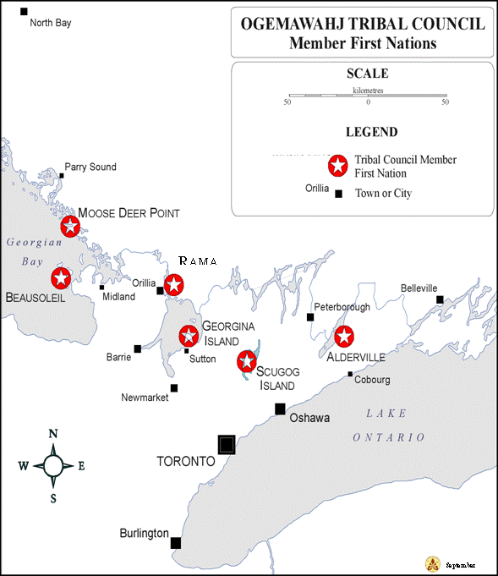
Organization/Governance

Slide 3
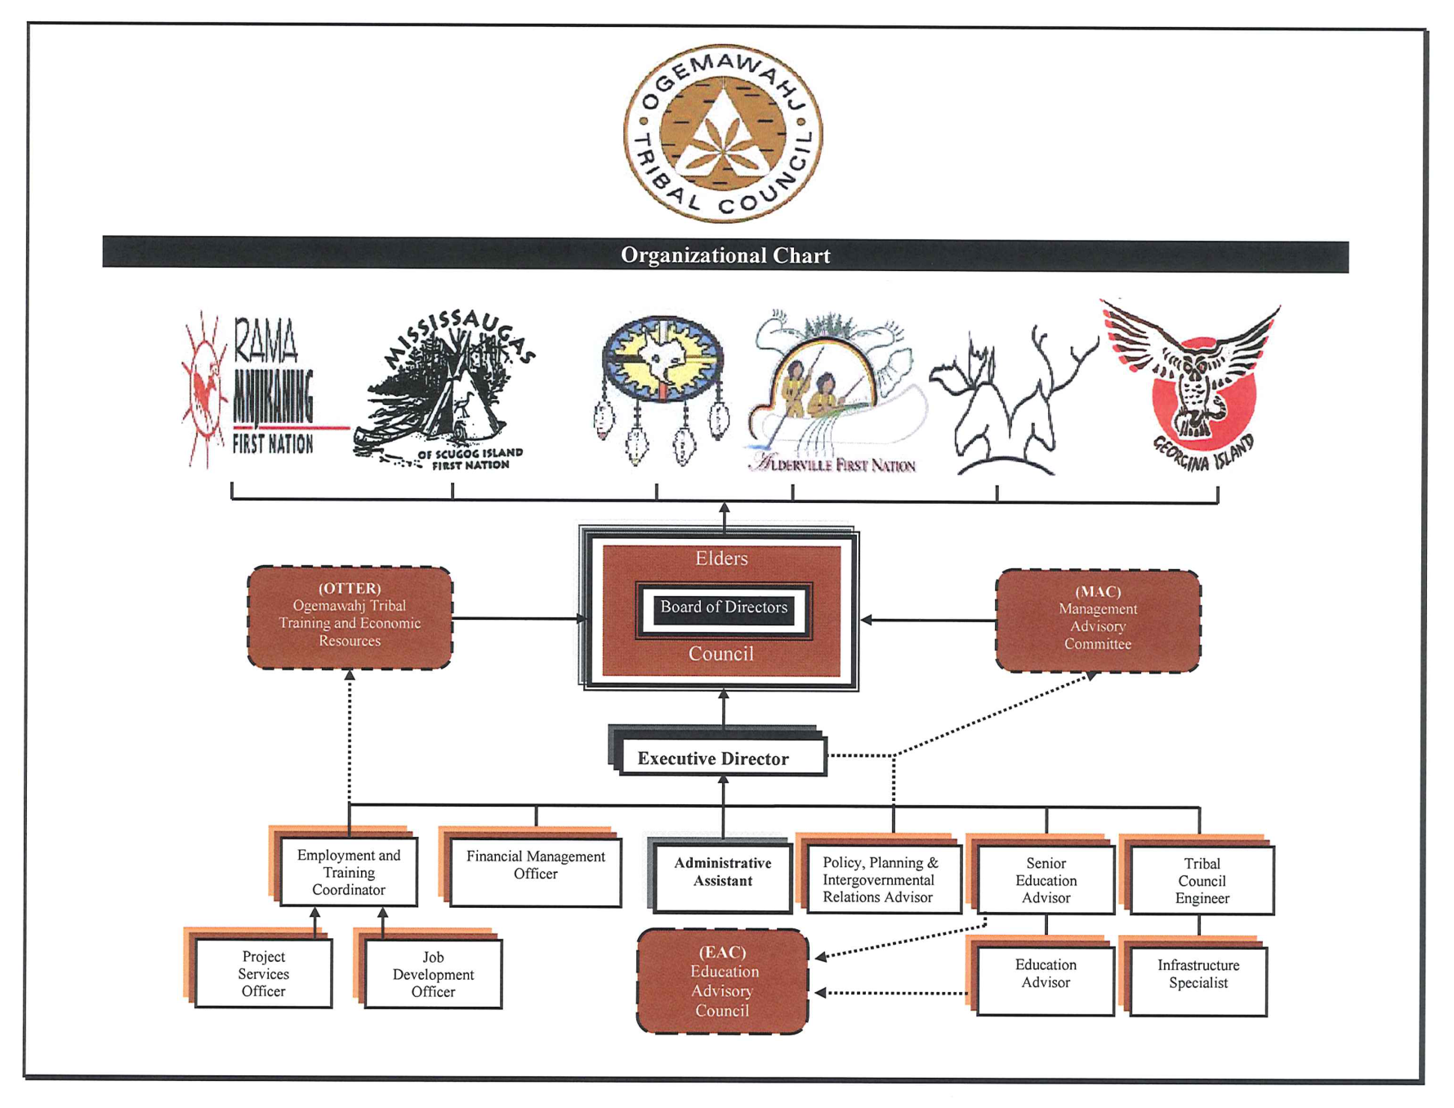

Slide 4
OTC
Ogemawahj Tribal Council represents an aggregation of 6 member communities providing service delivery and technical support in the areas of:
Engineering,
Infrastructure,
Education,
Employment and training,
Policy, planning and intergovernmental affairs
Financial management

Slide 5
OTC Schools
Chippewas of Beausoleil FN – Christian Island Elementary School K-8 with 110 students
Chippewas of Georgina Island FN – Waabgon Gamig First Nation School K-5 with 25 students
Chippewas of Rama FN - Mnjikaning Kendaaswin Elementary School K-8 with 143 students

Slide 6
Policy
Contract with each participating OTC Member Community regarding work plan and budget for FNSSP
Each community receives allocation for budget items directly handled by that community
All initiatives follow existing OTC Financial Policies and Procedures

Slide 7
Performance Indicators
The following indicators are being tracked:
Monthly attendance rate
Number of teaching days
Graduation rate
Retention rate
Literacy and numeracy test results
These will all be included as part of the School Success Plan process.

Slide 8
FNSSP School Success Plans
Currently at the end of year 1 of FNSSP
School Success Planning is underway in all 3 schools and draft plans should be developed by June 2011
Community consultation of plans will take place in September 2011 and plans will be finalized by December 2011
Annual plan revision and refining will occur in years 2 and 3
School Success Planning mentors from Provincial school boards are assisting FN school administrators

Slide 9
FNSSP Student Learning Assessments
EQAO testing has been done annually at Rama FN school
Georgina Island and Beausoleil will do EQAO testing in May 2011
DRA and PM Benchmarks are also being done
Some schools have done Canadian Test of Basic Skills but this will be discontinued in favour of other testing
Professional Learning Communities have been established and annual workshop with all staff of all 3 schools is held
Ministry of Education has done full day workshop on Assessment for, as and of Learning for all teachers

Slide 10
Literacy and Numeracy Coaching
Intensive literacy and numeracy coaching is now underway in all 3 schools with teacher-specific support being provided
Long term plans for teacher professional development will result from identified teacher learning needs as result of coaching
Targeted assistance with establishing accurate reading levels and establishment of data walls will result from coaching

Slide 11
Performance Measurement
2 schools are now using Trevlac First Nation Online Student Registry, 1 using Maplewood
Schools are entering historical data in order to be able to utilize long-term cohort information from report cards and assessment results
In year 2, OTC has applied for funding to enter the Compass for Success partnership to support Performance Measurement initiatives through data warehouse and detailed reporting provided by C4S

Slide 12
Positive Impacts of FNSSP
Professional Learning Community workshop had positive impacts
Classroom teachers who had full day pd on Assessment
Native Language teachers had full day pd on technology applications for teaching Native Language
Education Assistants had full day pd on specific strategies to meet the needs of students with exceptionalities
Coaching is providing targeted strategies to improve teaching practice

Slide 13
Sustainability
Capacity building is the foundation of all initiatives
Focus on improving access to literacy and numeracy resources and providing the necessary pd to ensure educators are comfortable using these resources
Unique element is Quill to Quill Literacy and Numeracy Strategy being developed based on images of quill baskets made by families in the OTC area
Certain positions, FNSSP Coordinator, School Success Team Leader, Reading Recovery Teacher, Student Retention Coordinator, are dependent on FNSSP funding over the long term so these services will not be sustainable if funding stops

Slide 14
Partnerships
School Boards – mentors for School Improvement Planning
Compass for Success hopefully
Indigenous Education Coalition hopefully – sharing server for Trevlac data and Compass for Success
No provincial funding or support is being received
OTC provided the base template to Chiefs of Ontario and Ministry of Education for standardization of Education Services Agreements

