Slide 1
FNSSP PRESENTATION
WIKWEMIKONG BOARD OF EDUCATION

Slide 2
PERSONNEL
PRESENTED BY:
DOMINIC BEAUDRY-DIRECTOR OF EDUCATION
MAXINE FERGUSON-PROGRAM MANAGER/COORDINATOR
MARJATTA LONGSTON-CONSULTANT
Notes:
WBE- presenters

Slide 3
FNSSP PERSONNEL
Julie Balen-Literacy Coach –Internal Secondment
Amanda Mishibinijima-Administrative Assistant
Dylan Shigwadja-IT Support
Numeracy Coach- to be seconded internally in the new fiscal year
Notes:
Members of our team

Slide 4
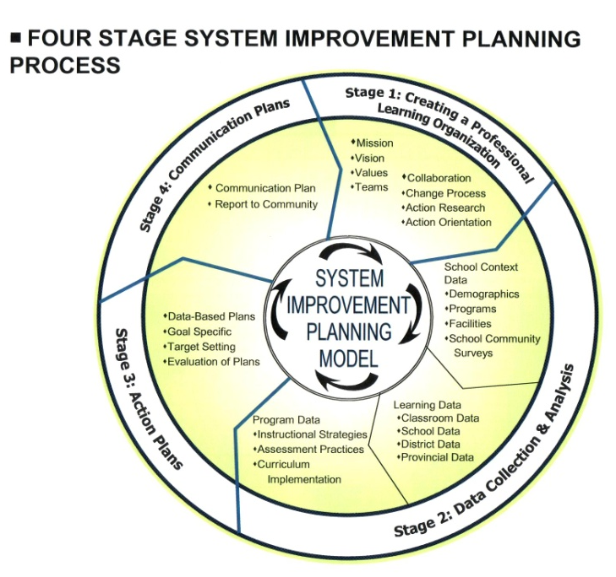

Slide 5
ORGANIZATION/GOVERNANCE
FNSSP-reports to the Wikwemikong Board of Education
Board of Education reports to the Band Council
FNSSP- does presentations for the Band Council
FNSSP is a department of the Wikwemikong Board Of Education. We are accountable to the Director and the Board.
Notes:
Wikwemikong-components of organization
FNSSP is a department within the board.
Reporting process-periodical to WBE and Band
Report to INAC-October and June
Report to the Board-October/May
Report to Band-November

Slide 6
Wikwemikong Board of Education’s program managers meet once a month to report and discuss issues arising.
FNSSP program manager does monthly reports for the Director of Education
FNSSP hosts weekly principal meetings
Professional Learning Communities are held each week.
Notes:
Once a month reports
Principal meetings are time to report progress/ keep track of where everyone is in the process of change.

Slide 7
Wikwemikong is located on Manitoulin Island on Georgian Bay in north eastern Ontario.
Wikwemikong has two elementary schools
One daycare/nursery school and Pre Kindergarten
One high school
An adult education program
A post secondary unit
A curriculum department-which is creating materials in the Anishinabemowin language for our education system
Notes:
Make up of Wikwemikong
Progressive community . Schools are well organized.

Slide 8
The Hub Centre-daycare/ Pre Kindergarten: 81 students-(45 –Pre Kindergarten)
Wasse Abin Junior : Senior Kindergarten to Grade 4- 210 students-Immersion program
Wasse Abin Pontiac: Grade 5 to Grade 8-163 students
Wasse Abin High School: Grade 9 to 12-216 students
Adult Education program
Notes:
Total number of students: Elementary and Secondary: 598
Including Junior kindergarten: 679

Slide 9
TEACHING STAFF
Hub Centre-11 ECE
Wasse Abin Junior-15teachers
Wasse Abin Pontiac-13teachers
Wasse Abin High School-18teachers
Educational Assistants-12
Special Education Resource Teacher-1
Adult Education-1 teacher
Total teachers-48 teachers
Notes:
Total teachers: 48
Educational assistants: 12/ ECE: 11(at hub centre)

Slide 10
AGGREGATE
AGGREGATE does not apply to the Wikwemikong Board of Education.
We are funded as a stand alone community.
We provide all our own second level services.
Our FNSSP program works with our consultant to provide school improvement through the funding that we received from our proposal.
Notes:
We are providing services with the assistance of an external consultant who has worked with the Secretariat at the Ministry of Education inOntario on numeracy and Literacy. Also has been a principal and director of education Mr. Beaudry oversees our whole program.

Slide 11
COLLABORATION
As stated we are a stand alone community.
Our whole program is based on teachers within the WBE collaborating with each other to assist students to be successful
We are establishing Internal Capacity
Hosted a community Open House
We are hosting a conference in October that two First Nations in our area with schools have expressed an interest in attending.
The Conference is on October 6th and 7th.
Featuring-Dr. Anthony Muhammad-Transforming School Culture;
Tom Hierck-Professional Learning Communities
Susan Stephenson-Laughing Matters
We have presented information to the Parent councils.
We have initiated inter agencies meetings in Wikwemikong.
Notes:
WE need to build internal capacity and this has started with the direction of teacher collaboration and then having the principals collaborate with each other. Professional learning communities engage teachers in looking at data together and then working together to design best practices for their classroom. School Improvement teams with the principal as it leads also looks at data and decides on the SMART goals which team members take back to PLC to discuss and design ways to meet the targets. The literacy coach assists as will the numeracy coach.

Slide 12
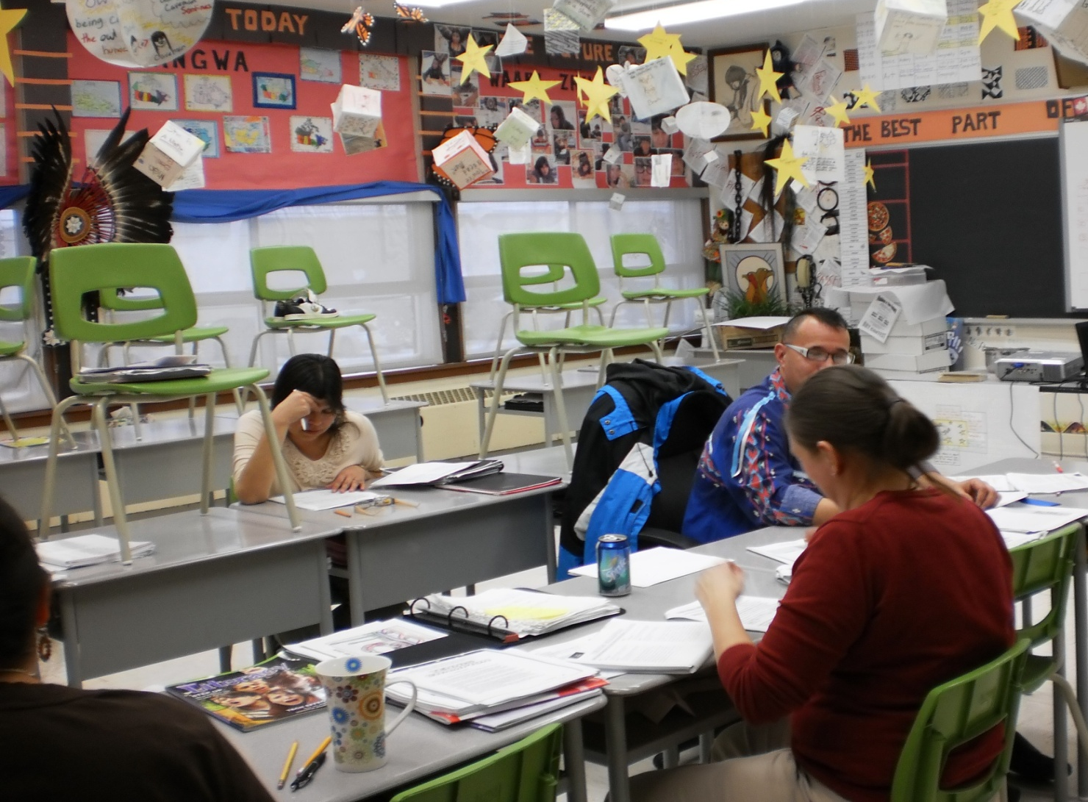
Grade 7 & 8 PLC Group

Slide 13
POLICY
School Success
School Improvement Teams
Professional Learning Communities
Weekly principal meetings
Literacy coach
Instructional walk throughs
Notes:
To ensure staff follows guidelines and roles, we have set up the above components. Each group supports and collaborates with each other . Each team is interconnected as members are going back and forth. We are developing collegial aspects which opens the door to trust and collaboration. This is about the Success of students not the individual teacher or principal. Principals have been trained by our consultant to do walk throughs which allows them to visit classrooms in a non threatening manner and then pose reflective questions to the staff member that has them think about their practices when teaching and how they plan. The weekly principal meetings allow principals to discuss issues and provide an united front on the best practices.

Slide 14
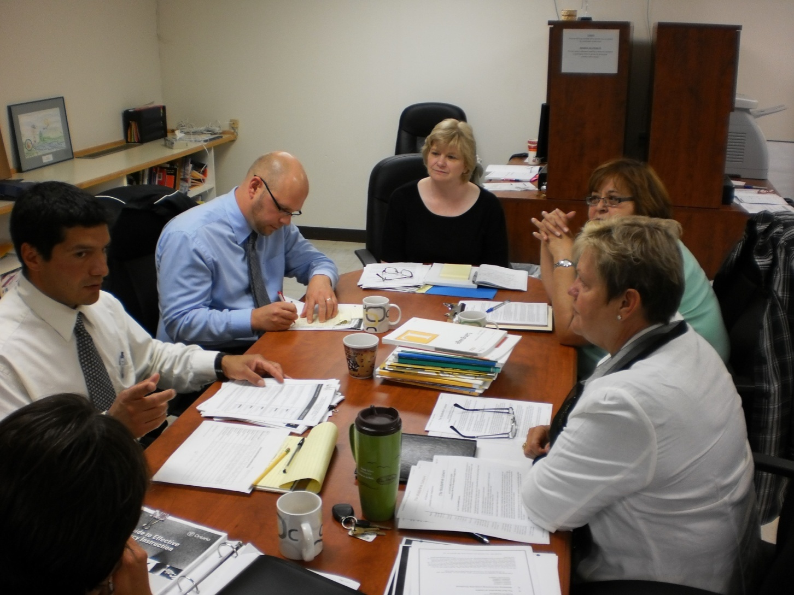
Weekly Principal Professional Development with Consultant Marjatta Longston

Slide 15
Student Assessment
Teachers are required to administer 4 to 6 times a year-standardized testing-PM Benchmarks/ Fountas & Pinnell Benchmarks/CASI –(Comprehension/ attitudes/ strategies/interests reading assessment)
OSSLT-high school-March
EQAO-elementary –June
Web Based tracking system-Trillium and Students Achieve
Non negotiables
Notes:
We have the teachers assessing the students literacy every 6 to 8 weeks cycle. PLC’s as well as the School Improvement team look at the data to analyze and decide on next steps. Cyclical school improvement-

Slide 16
Performance Measurement
Trillium
Attendance
Report cards
Students Achieve
School Wide Assessment Tool
Special Education Tool
Assessment Policy
Email server
Web page
Notes:
Pictures?

Slide 17
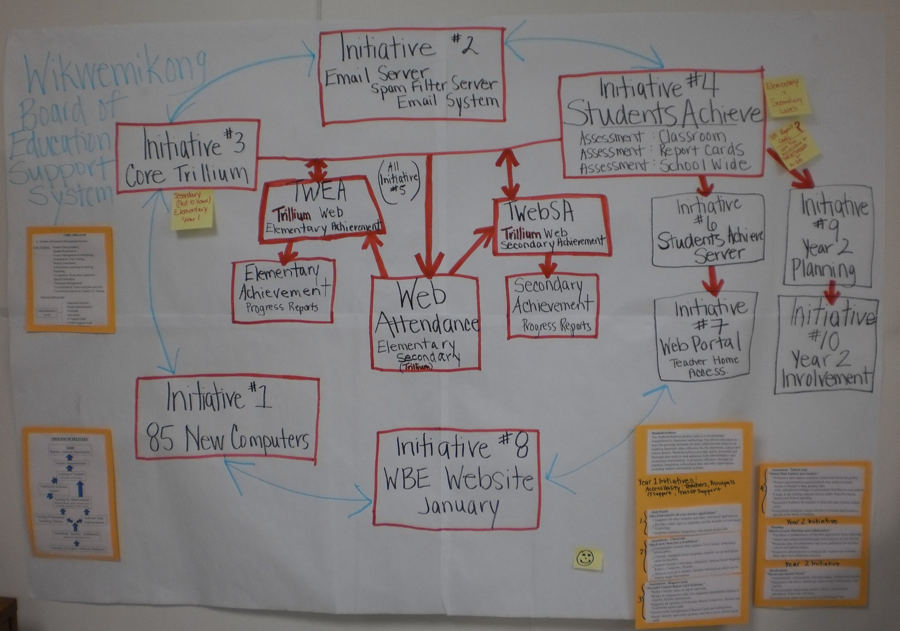
Wikwemikong Board of Education’s FNSSP
Information Technology Plan Year 1 & 2

Slide 18
PERFORMANCE INDICATIORS
SMART Goals
Cyclical school improvement planning
School Improvement Plans
Data collection
Notes:
Handouts of templates/ explanation of SMART goals /graph of data collection

Slide 19
SUPPORT
Weekly Principal meetings
School Improvement Teams
School walk throughs
Professional development
Literacy coach
IT support
Assessment Policy
Professional Learning Communities
News letter
Teacher appreciation
Notes:
Internal Capacity building

Slide 20
TIME LINE
2010-2011
Establish a tracking system for elementary schools-purchased Trillium
Used for attendance, reporting , tracking, reporting for COOP programs, Student lists, busing information, special education tracking
Purchase Student Achieve –Online collaboration for students, parents, teachers and administration. Allows K to 12 students to maximize learning.
Purchased the School Wide Achievement program to track assessment data
Purchased curriculum planner a year ahead of schedule.
Reporting to parents uses these two systems-3 reporting periods for elementary/ 4 reporting periods for High School
Establish Book Rooms
Notes:
Add picture of a book room

Slide 21
Establish an email server for communication within the Board
Purchase dedicated computers for the desk top of each teacher
Establish a web page for the Board
Establish PLC committees at each school
Provide professional development for principals
Establish collaboration in all three schools among teachers
Provide professional development for teachers
Notes:
Book talks, communication, collaboration, numeracy and literacy coaches, Internal capacity building-self sustaining/add picture

Slide 22
TIMELINE
2011-2012
Purchase portal for parents to access marks-Student Achieve
Purchase SMART BOARDS for the Junior School and High School
Second a Numeracy coach
Continue with the Literacy coach
Continue with IT support
Refine the PLC committees
Continue ongoing principal training
Continue cyclical school improvement planning
Add High School EQAO grade 9 math test
Continue to purchase best literacy resources as well as math resources
Set up Demonstration classrooms
Conference in October 2011

Slide 23
PROGRAM
School Success
Numeracy coach will be seconded for the second year of the proposal
Literacy coach in place
IT support
School Improvement Plans have a new template
Principals have received support on a weekly basis
Principals attended a conference in Ottawa-concerning PLC’s
Notes:
Picture of principals meeting

Slide 24
Student Learning Assessment
Purchased Literacy Program-Nelson.
Both elementary schools are using this
Literacy coach working with K to 12 teachers
Literacy coach is setting up demonstration classrooms in each of the schools
Book rooms are being set up in the schools
Tracking walls are being implemented in the schools
Notes:
Pictures of students

Slide 25
Each classroom has a PM benchmark at the K-3 level
Grade 5 to 8 school has Fountas and Pinnell benchmarks
CASI- is being used in grades 5 to 8
High School is using OCA-Ontario Comprehension Assessment
Indicators of success data collected shows modest gains in the achievement level of students

Slide 26
Performance Measures
Trillium tracking system is implemented
Student Achieve- accessible from home by teachers
Report cards are web-based and accessible from home
School Wide Achievement tool allows schools to collect data from the testing, track, graph and find areas that need to be improved
Special education has a tool to track IPRC meetings
COOP program is being tracked

Slide 27
EVIDENCE OF FNSSP SUCCESS
Students have shown a growth in meeting the SMART goal by January reporting period
Teachers are collaborating –PLC’s are up and running at all three schools
Literacy block has been established at the elementary level-100 minutes of uninterrupted literacy first time block each morning.
Junior School and the Hub Centre had a successful Literacy Day
Email Server is being used by staff
Notes:
Picture of PLC/Literacy block

Slide 28
Web page will be up and running by March 31, 2011
Each teacher has a dedicated computer
Tracking of student success is taking place at all levels –every six to eight weeks the students are assessed to plan for instruction
Materials have been purchased to support the teachers in presenting a well balanced literacy program
Trillium and Student Achieve are being used by the staff
Established an assessment policy for the Board

Slide 29
Data bank is growing. This is leading to student success as data shows where more work is needed
Establishment of SMART Goals
Shift happening to strong collaboration and internal capacity building
Establishment of pyramid of interventions for each school
Professional learning is growing and is an expectation
The cycle of learning is also an expectation. Assessment of/ for learning takes place on a 6 to 8 week cycle.
Shared understanding by all staff of where we want to go
Communication between all schools
School Improvement team is organized at each school

Slide 30
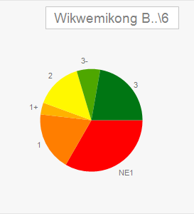
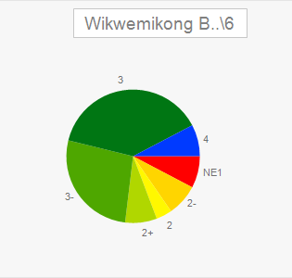
Grade 6 CASI Results
Understanding Text Forms
Before
After a 6 week
Instructional Cycle
Notes:
Created by using the Students Achieve’s School Wide Assessment tool
CASI-Comprehension/ attitudes/ strategies/interests reading assessment)

Slide 31
SUSTAINABILITY
Continue with the principal meetings
Provide continuous training for principals
Continue with PLC’s –support the collaboration among teachers
Literacy coach will continue to support teachers
Numeracy coach will provide support for the teachers
Build internal capacity
On-going professional development for teachers

Slide 32
UNIQUENESS
Stand alone program-not a part of an aggregate
Collaboration is part of the planning at all levels
Established a continuous school improvement program
Professional learning communities are established
SMART Goals
Template for School Improvement Planning
Continuous principal support and training
Instructional walk throughs

Slide 33
PROVINCIAL PARTNERSHIPS
At this point we do not have provincial partnerships.
All our students who live in Wikwemikong are expected to attend school in Wikwemikong until they reach post secondary.
We do not have any tuition agreements with the province.
We have attended provincial professional development activities.
Provincial Literacy coaches are providing a workshop for grade 7 to 12 teachers in April.

Slide 34
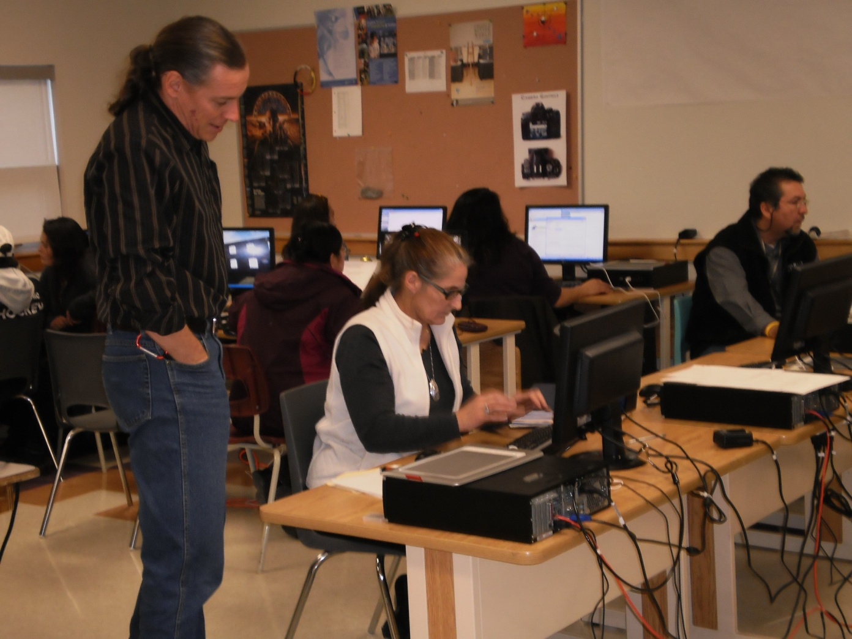
Teacher Professional Development
Internal Capacity Building
Peter Baumgarten, High School - Teacher Trainer with staff

Slide 35
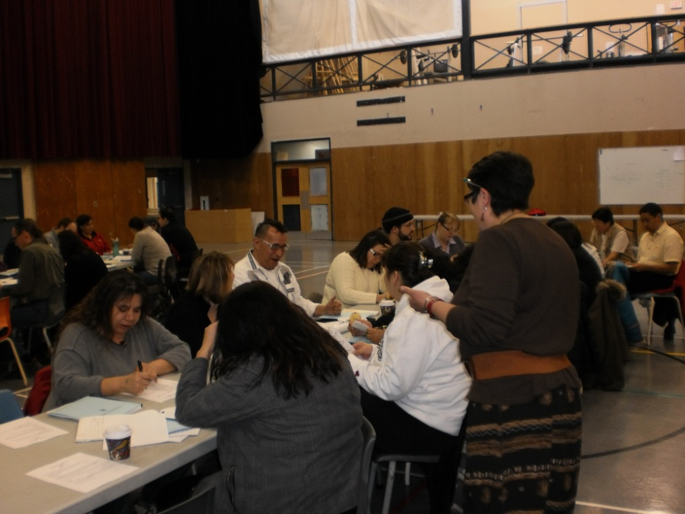
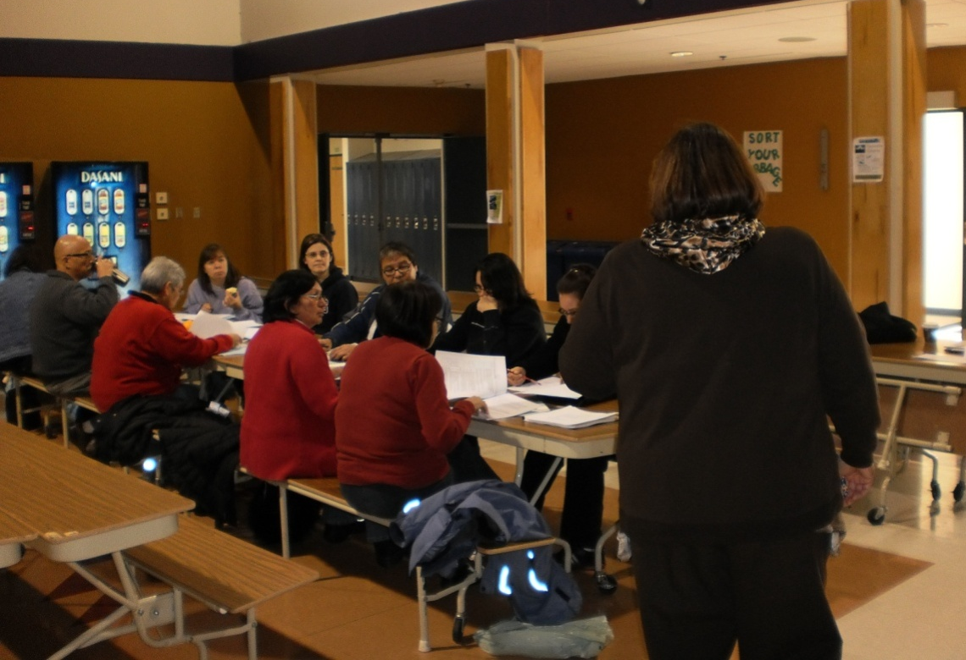
Teacher Professional Development
January 21, 2011

Slide 36
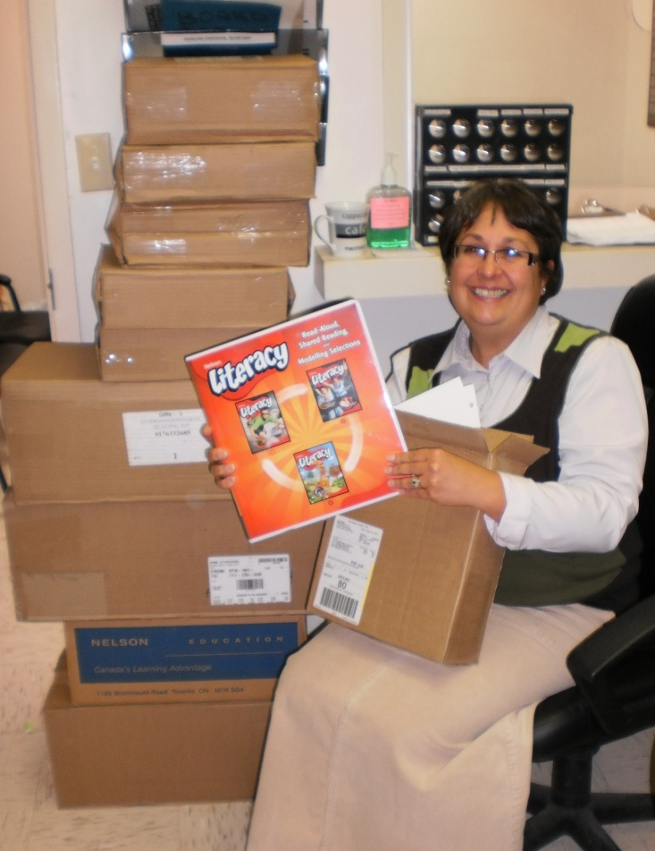
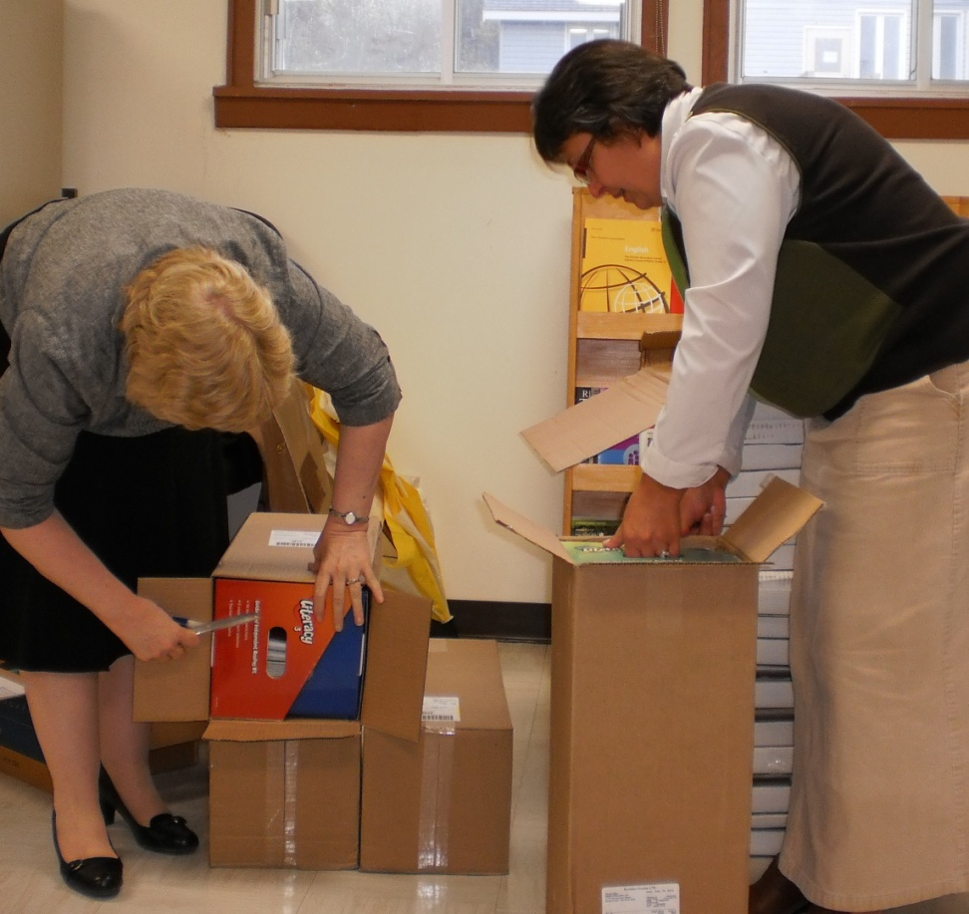
Enriching Our School Environments with Literacy Resources
Literacy Coach, Julie Balen
FNSSP Coordinator, Maxine Ferguson & Julie Balen

Slide 37
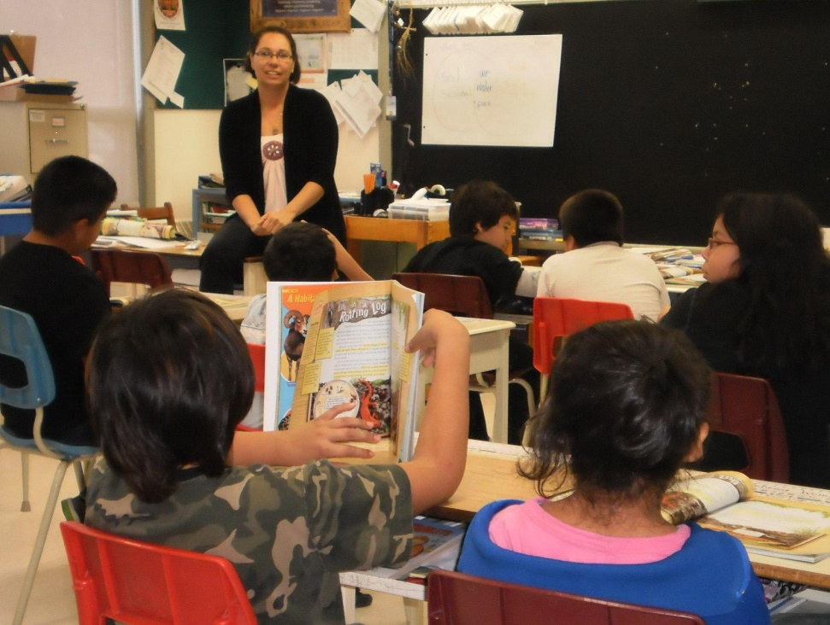
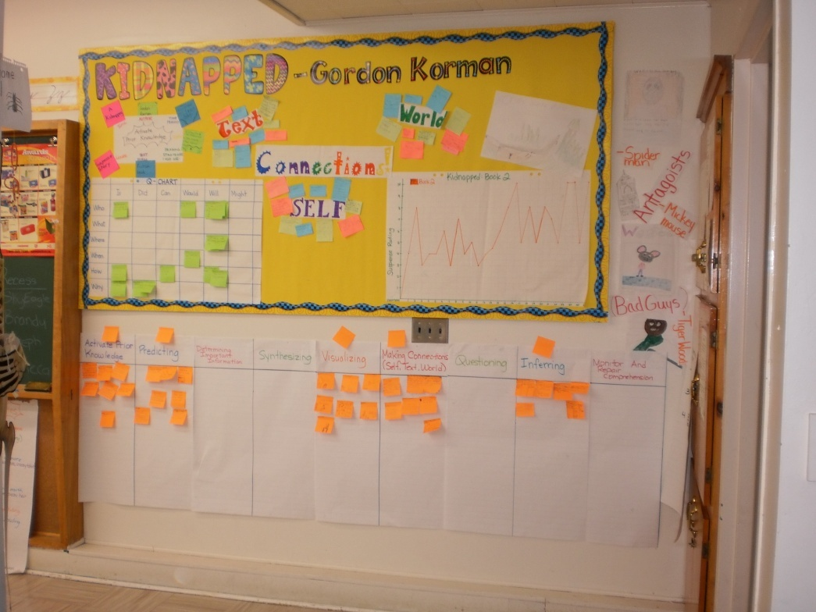
Balanced Literacy Block

Slide 38
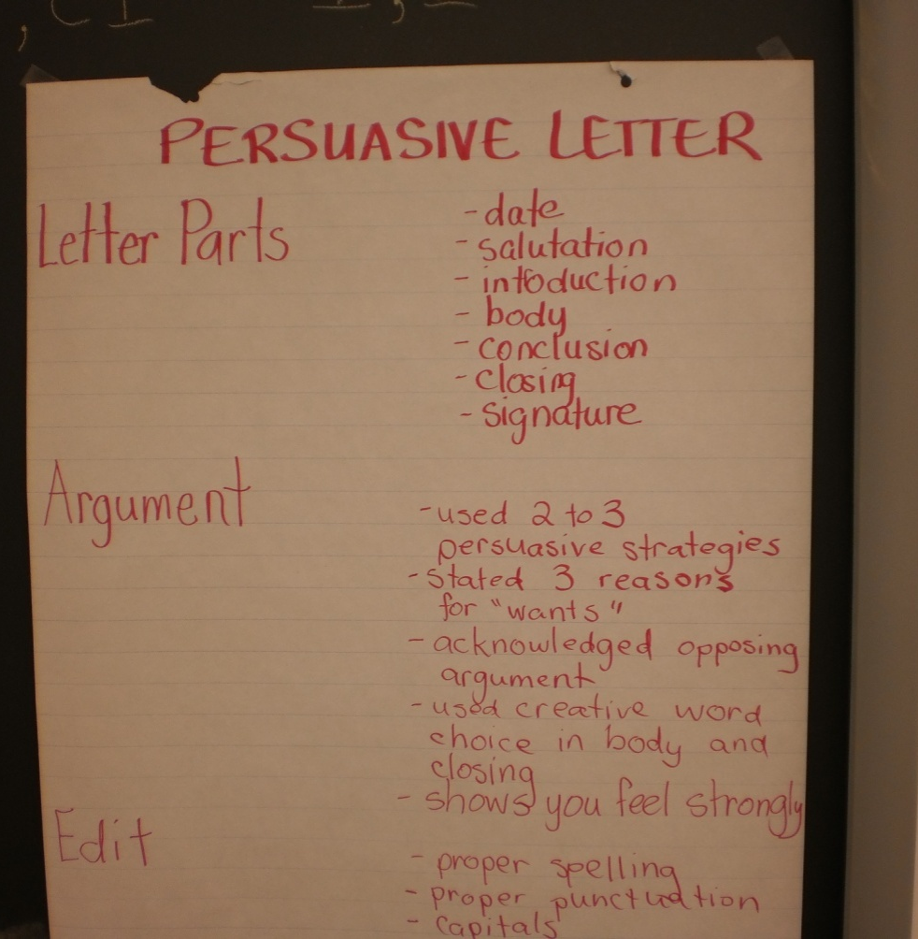
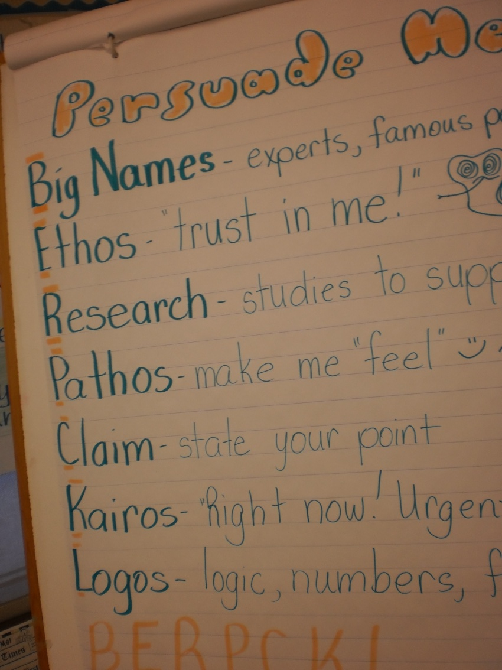
Anchor Charts
Balanced Literacy Block

Slide 39
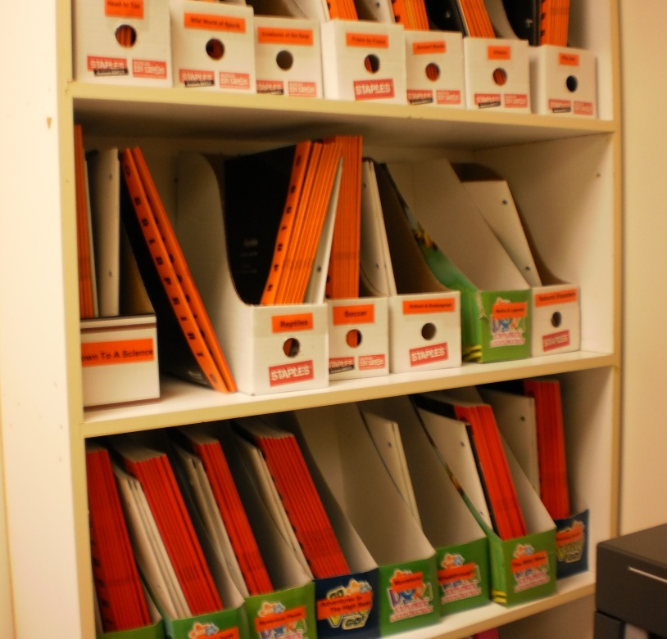
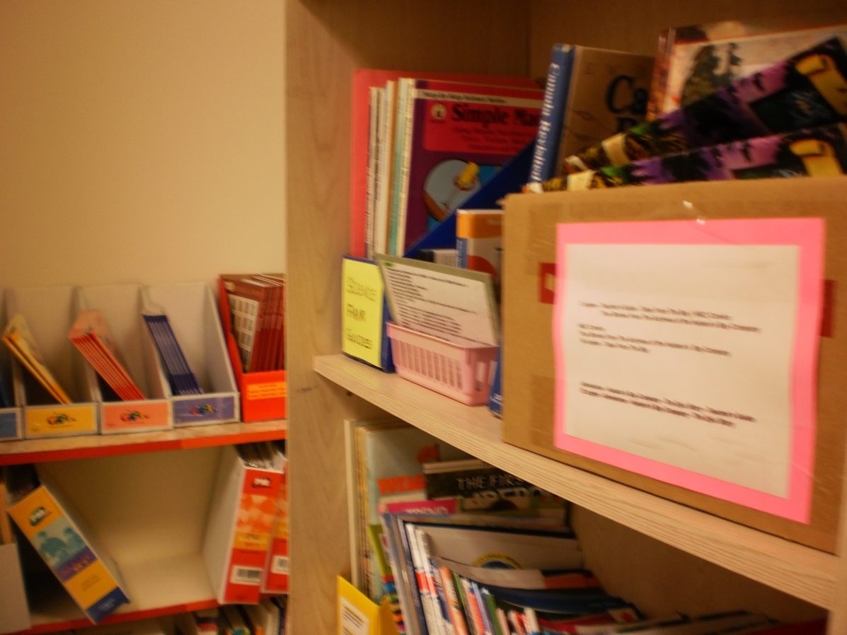
Wasse-Abin Pontiac School
Book Room

Slide 40
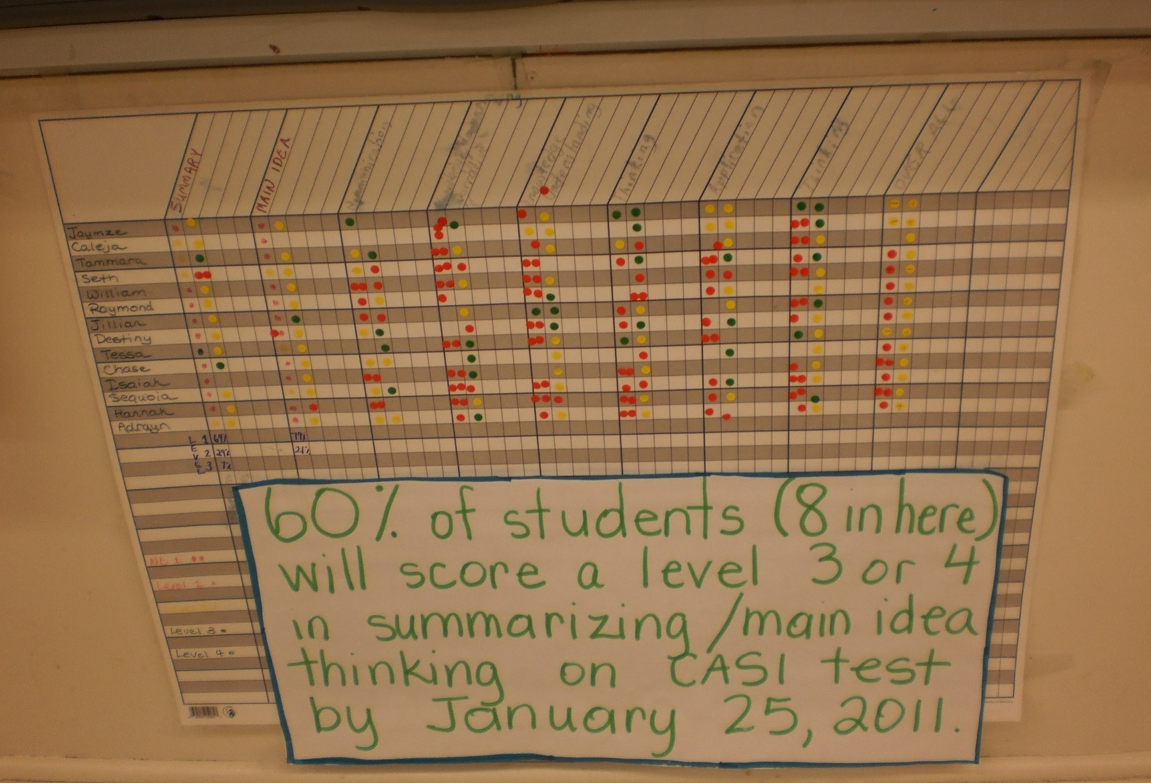
SMART Goal Setting

Slide 41
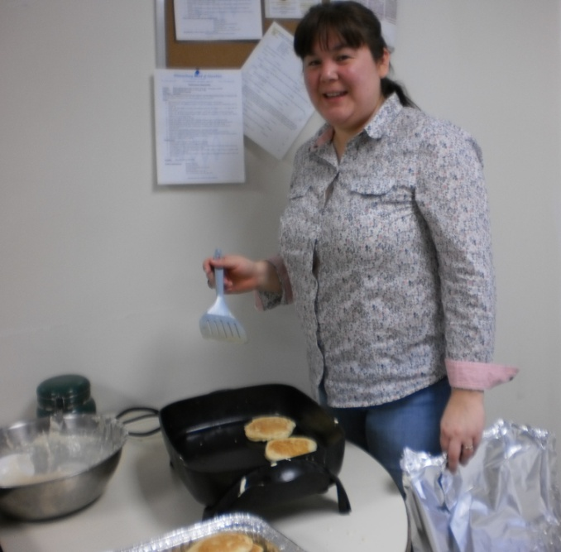
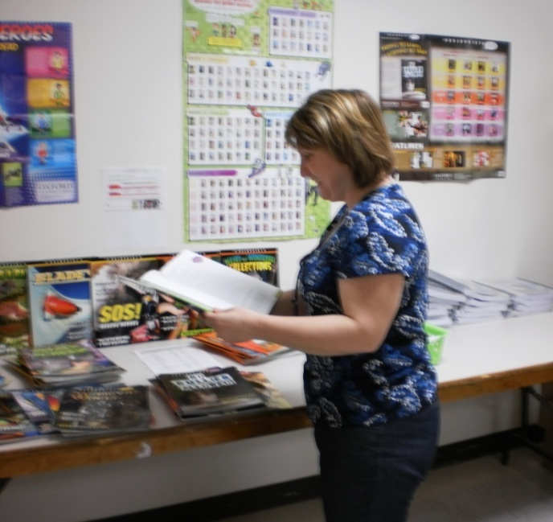
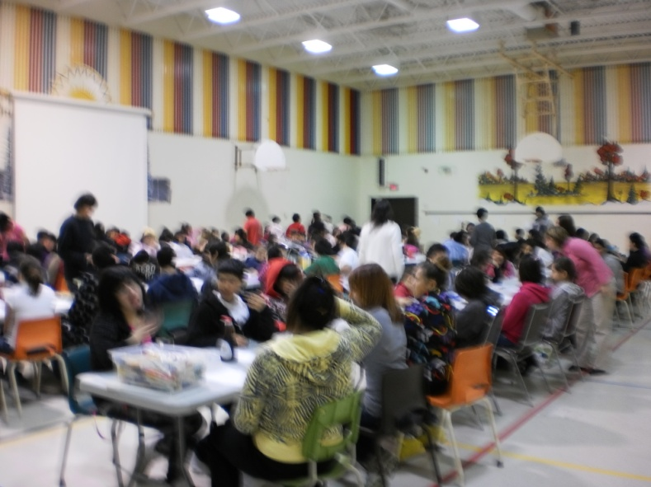
Celebrations
Teacher Appreciation Event
Pancake Breakfast Celebration for Students & Staff

Slide 43
