Slide 1

First Nation Student Success Program Mushkegowuk Communities
March 2011

Slide 2
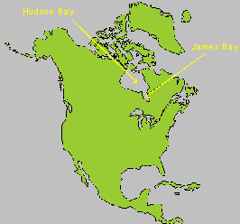
Geographical Area
Where is James Bay anyways?

Slide 3
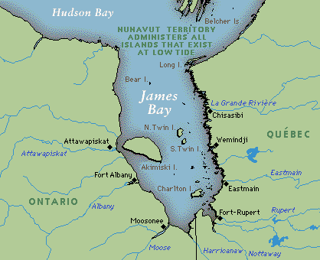
West Side of James Bay
Attawapiskat
Fort Albany
Kashechewan
Moose Factory

Slide 4
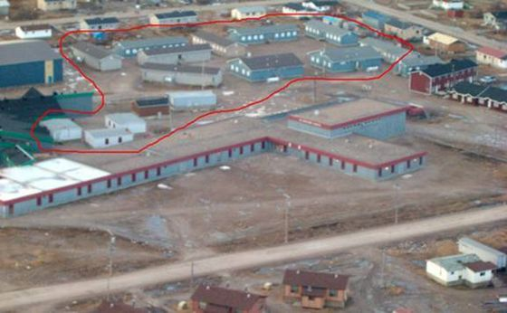
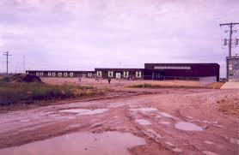
Attawapiskat
Portables
400+ Students

Slide 5
OE FNSSP REPORTING STRUCTURE
Omushkego Education Board of Directors
Consultants
Jim Hollander
Tom Steele
Dr. Laurie Bizero
OE Principals Committee
Donna Seary OE Director of Education
OE Principal’s Committee
Bernice Kapashesit FNSSP Program Manager
Lucyann Friday Finance Clerk
Bernice Kapashesit, FNSSP Program Manager
Trina Friday, Executive Assistant
Susan Byron, Student Success Planning Co-ordinator
In 3rd Year Student Learning Assessments Co-ordinator
Michael Adekunle School & Student Performance Measurement Co-ordinator
Debbie Corston, Data Clerk
Vacant, Data Management Trainer
Vicki Von Zuben , Literacy Coach
Vacant, Numeracy Coach
In 3rd Year Student Learning Assessments Trainer
Lorna Redwood & Marilyn Holmes, Numeracy Advisors

Slide 6
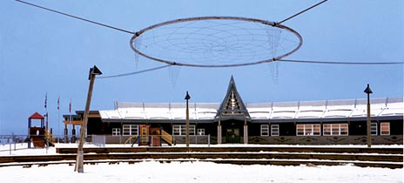
Fort Albany
Peetabeck Academy
– School & Community just celebrated 10th Year Anniversary – services both Elementary & Secondary Students

Slide 7
OE FNSSP – Numbers
COMMUNITY | SCHOOLS | # of Teachers | # of Support Staff | # of Students
Attawapiskat | JR Nakogee Elementary School | 21 | 24 | 425
Attawapiskat | Vezina Secondary School | 21 | 31 | 162
Fort Albany | Peetabeck Academy Elementary | 10 | 8 | 120
Fort Albany | Peetabeck Academy Secondary | 8 | 8 | 52
Kashechewan | St. Andrew’s Elementary | 21 | 17 | 412
Kashechewan | Francine J. Wesley Secondary | 12 | 6 | 134
Moose Factory | Delores D. Echum Composite School Grades 9-12 | 15 | 14 | 150
TOTAL | 7 Schools | 108 | 108 | 1455

Slide 8
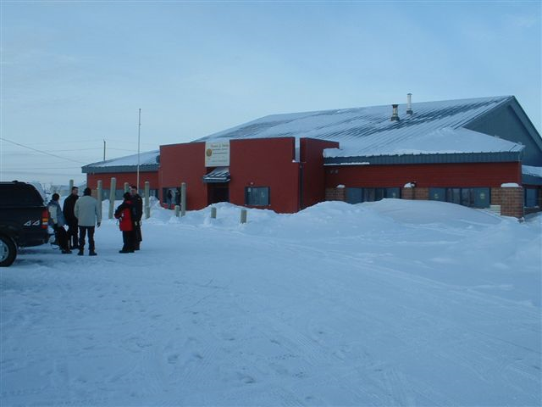
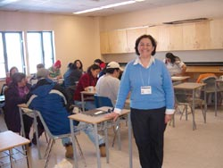
Kashechewan
St. Andrew’s School
Francine J. Wesley School
300 + Students
Donna at GMG in Kashechewan a few years ago.

Slide 9
Aggregate
Mushkegowuk Council is a tribal council which services 7 First Nation Communities. Omushkego Education services 8 First Nation communities.
On-Reserve Schools in Attawapiskat, Fort Albany, Kashechewan, and Moose Factory fall under the umbrella of FNSSP. All other First Nations students within MC go to Provincial Schools.
Omushkego Education is a regional educational organization whose primary function is to support our First Nation communities, their respective Education Authorities, Education Departments, Day Cares and Schools by way of curriculum development and support services.

Slide 10
Does the Aggregate Influence Funding?
As a Tribal Council, yes, our aggregate does influence our capability of receiving funds to implement FNSSP.
Omushkego Education Board of Directors and Principal’s Committee, meet on a quarterly basis and are aware of what is going on in the Mushkegowuk area.
Provide professional development, i.e. Great Moon Gathering which has a Cree cultural and language component.

Slide 11
Aggregate (cont’d)
The geographic size and remoteness of the Mushkegowuk territory results in increases costs for travel, accommodations, and meals for our staff. However, aggregation increases the ability of Mushekgwouk schools to work together and provides economies of scale.

Slide 12
Collaboration with First Nation
Yes, we do.
Nishnawbe Aski Nation
Ojibway Cree Cultural Centre
Chiefs of Ontario
KNET
Peawanuck First Nation

Slide 13

Moose Factory
Delores D. Echum Composite School
Recently Celebrated 10th Year Anniversary
Grades 7-12 students

Slide 14
FNSSP Policy
With respect to the 3 program components, our staff have gone through the Hiring Process under the Mushkegowuk Council Hiring Policies, Employment Regulations, and Financial Regulations, etc.
These are clearly articulated to the Directors of Education and Principals of the Mushkegowuk schools through OE Board of Director’s and Principal’s committee meetings or addressed individually at the community level.

Slide 15
FNSSP Policy (cont’d)
OE follows the work plans developed for each of the program components (currently students success and performance measurement). At this preliminary stage performance of the outcomes is measured by completion of the outcome for each of the participating schools.
The OE Director of Education works closely with the Program Manager as needed and through monthly reports. Additional support for success is provided by the OE Board of Directors on a quarterly basis.

Slide 16
FNSSP Policy (cont’d)
Where funding is provided directly to schools, the OE Finance Officer works with the Program Manager and schools as needed and provides updates on spending through monthly reports to ensure accountability.

Slide 17
Programming
Timeline for School Success Planning Component
Hired Susan Byron, Co-ordinator, Nov/10.
Hired Tom Steele, SSP Consultant - Dec/10.
Hired Vicki von Zuben, Literacy Coach - February 2011.

Slide 18
Programming
LITERACY
Fast ForWord – pre-implementation stage, i.e. Training
This Literacy program is based on solid scientific evidence-based research which improves Literacy levels
This program is being used in Toronto, i.e. Yorkwoods Public School
www.scilearn.com
John Hopkins, Canadian Representative

Slide 19
SSP (cont’d)
Attended Reading Recovery Conference to explore approaches to Literacy improvement such as Story Telling, Movement, current
Brain Research and its place in Education;
Facilitated distribution of new book donations to the MC First Nation schools;

Slide 20
Performance Measurement Component
Hired Michael Adekunle, Co-ordinator, Nov/10
Hired Laurie Bizero, PM Consultant – Nov/10
Hired Debbie Corston, Data Clerk – Feb/11

Slide 21
Performance Measurement (cont’d)
Workplan development in collaboration with Consultant;
Administered Surveys to determine Data Management Systems needs, i.e. who uses it and how often;
Maplewood Training is the Data Management system used in MC Schools;
PM Co-ordinator and 2 representatives from each MC school attended Maplewood training just this month;
The trained reps will then train the teachers and administrative staff.
The PM Co-ordinator, with the assistance of Maplewood staff will clean up the data to eradicate duplication of information.

Slide 22
Program Timelines
INAC approved our amended proposal in June 2010!!!
We are grateful to Mushkegowuk Council for financially carrying us from August to December 2010;
Hired FNSSP Program Manager in August 2010.
Developed job descriptions and requirements for co-ordinators, consultants, coaches and administrative staff.
Presently, we are about 8 months behind schedule with School Success Planning and Performance Measurement; and, the Student Learning Assessments component may begin in the Fall.

Slide 23
Uniqueness
Our geographical location sets us apart from other First Nations;
We are the Omushkego Cree people as compared to Oji-Cree and Ojibway;
We have different traditions and cultures; our schools are closed for annual Fall and Spring Goose Hunt breaks;
We all belong to the Mushkegowuk Tribal Council;

Slide 24
Uniqueness (cont’d)
Politically, we have our own Grand Chief and Deputy Grand Chief;
We have the staff resources within our own First Nations communities;

Slide 25
Provincial Partnerships
Our Lead Consultant works for Northeastern Ontario School Association (NEOSA) as a Supervisory Officer and a Student Success Team Leader for James Bay Lowlands Secondary School Board (JBLSSB);
He attends our OE Principals Committee meetings and provides current Ministry of Education information;

Slide 26
Provincial Partnerships (cont’d)
We also have provincial school Principals attend our OE Principals Committee meetings.
Great Moon Gathering (Professional Development for Educators) – facilitators from Toronto Catholic District School Board, Moosonee District School Area Board, Northeastern Catholic School Board, District School Board Ontario Northeast;
Ministry of Education – Ontario Aboriginal Education Strategy

Slide 27
Provincial Partnerships (cont’d)
Education Provincial Partnerships – we submitted a proposal but have not received a response;
EPP is a tri-partite agreement between INAC, Ministry of Education, and First Nations which will cover tuition agreements and student transition.

Slide 28
Challenges
Delayed approval and funding for FNSSP ;
Salaries – low compared to provincial schools;
Qualifications – we have high expectations for our positions, i.e. B.A. and B.Ed., Principals Qualifications;
Contracts – teachers were unable to breach their contracts;
We had to hire staff under short-term contracts;
Office Space – limited office space; renovations required;
Travel Costs – to remote, isolated northern communities;

Slide 29
Challenges (cont’d)
Culture of Communities – schools close down when a death occurs in the community;
Weather disruptions – schools close due to frigid temperatures; flight cancellations; staff gets stranded in communities due to fog or bad weather;
Maplewood Training – this training is not readily available; limited training dates due to volume of training requests; costs to attend training.

Slide 30
Meegwetch!!
From the FNSSP Staff in Mushkegowuk Territory

