Slide 1

Matawa First Nations

Slide 2

Who We Are
A Tribal Council of nine Ojibway and Oji-Cree First Nations
Road access First Nations are:
  Aroland, Ginoogaming and Long Lake #58.
Remote access First Nations are:
  Eabametoong, Neskantaga, Marten Falls, Nibinamik and Webequie First Nations

Slide 3
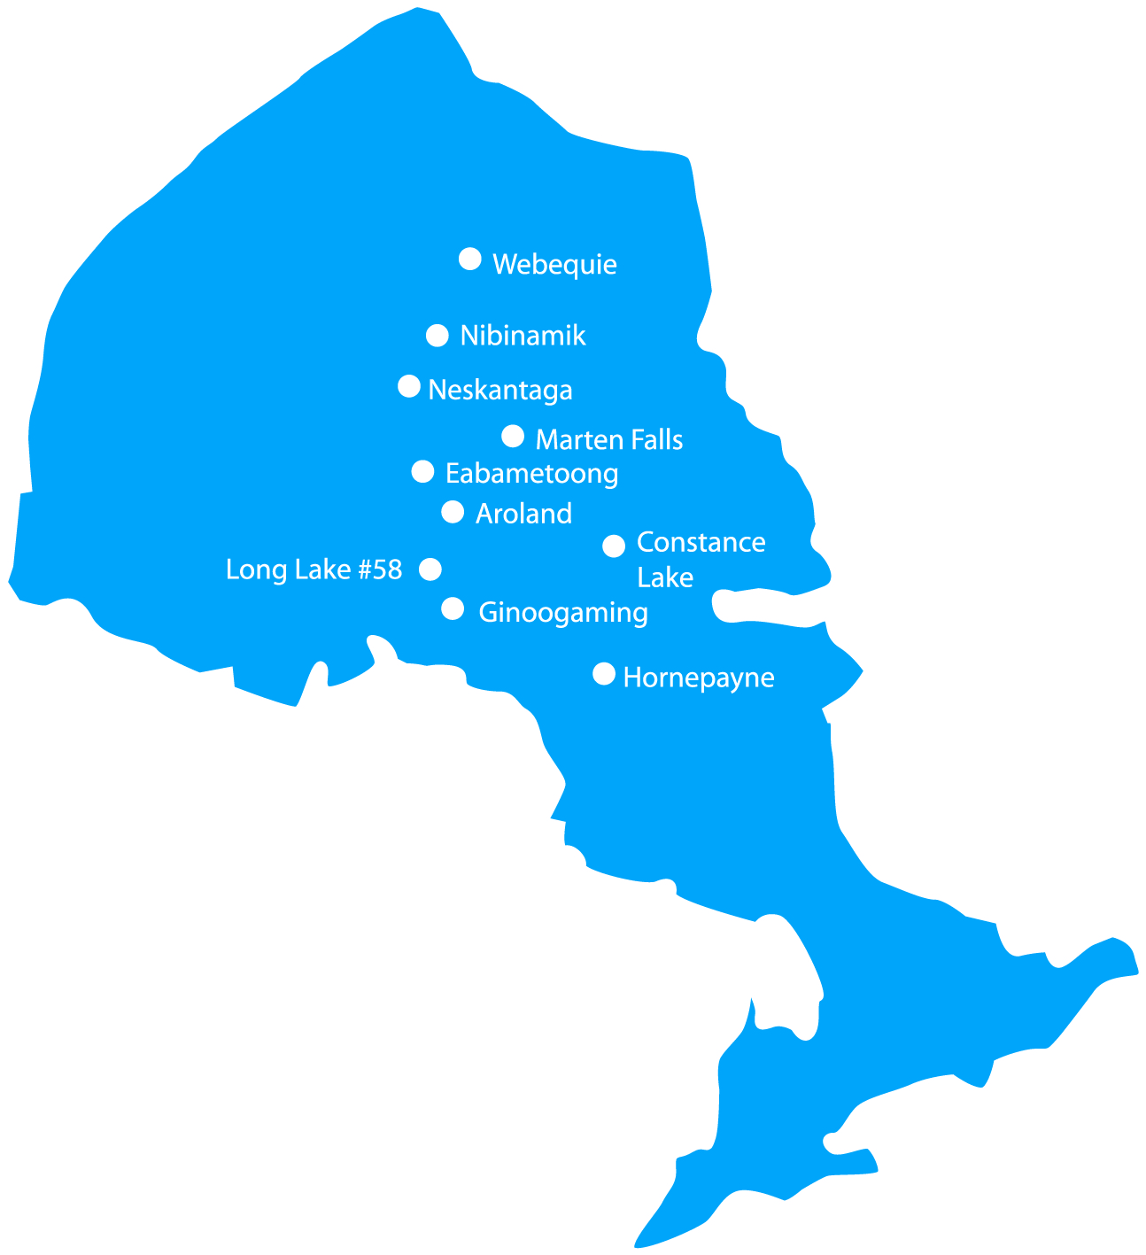

Slide 4
Who We Are
Matawa First Nations work together to build capacity and strength
Community needs always come first
A shared strategic priority is:
Building Educational Strength

Slide 5
Matawa First Nations Schools
Johnny Therriault School - Aroland First Nation
John C. Yesno Education Centre - Eabametoong First Nation
Niimiki Migizi Secondary School - Ginoogaming First Nation
Migizi Wazisin Elementary School - Long Lake #58 First Nation
Henry Coaster Memorial School - Marten Falls First Nation
Neskantaga Education Centre - Neskantaga First Nation
Nibinamik Education Centre - Nibinamik First Nation
Simon Jacob Memorial Education Centre -Webequie First Nation

Slide 6
Governance in Education
Matawa First Nations Education Department and Learning Centre.
The Education Department supports initiatives that result in school success planning and improved student performance.
Regional Education resources and tools including: post-secondary programs, teacher conferences, website portal etc.

Slide 7
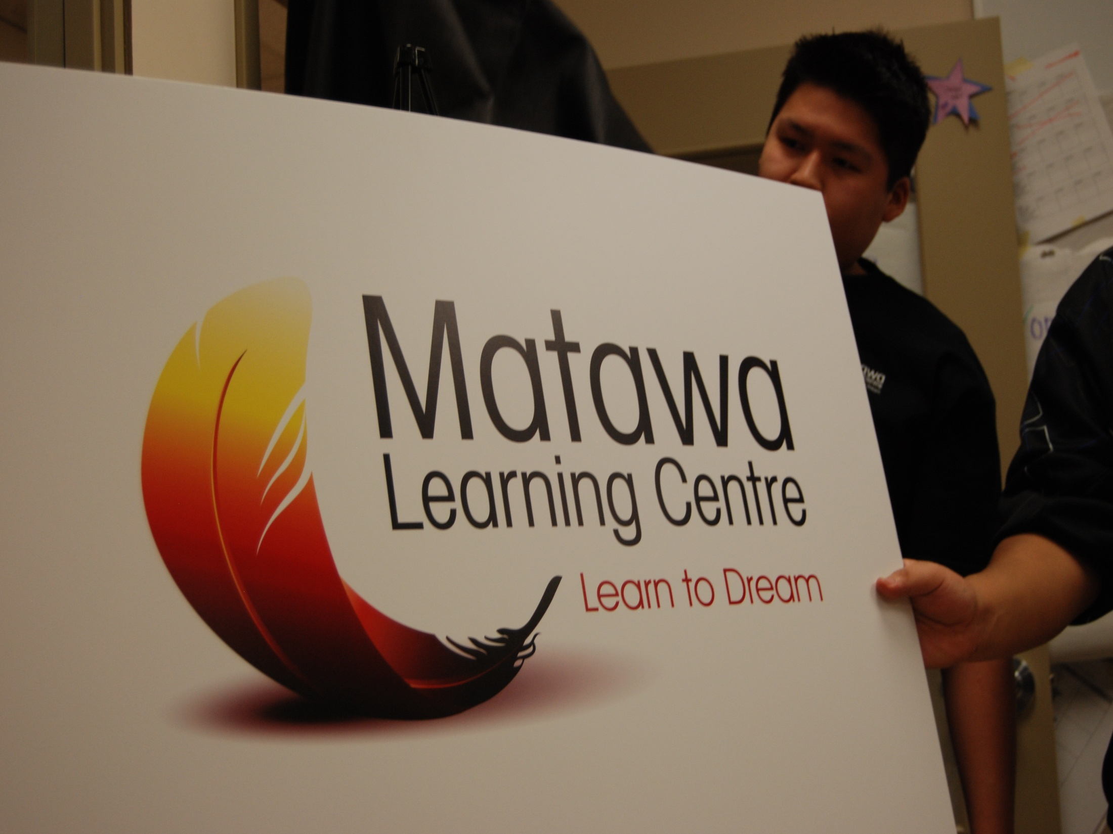

Slide 8
Governance in Education
A Matawa First Nations Regional Committee on Education advises the Education Department
The Committee has representatives from each Matawa First Nation
Every First Nation has a Local Education Authority (LEA)

Slide 9

Matawa Education Vision…
Matawa First Nations delivers quality, accessible and student-centered education in a culturally appropriate environment to accommodate diverse needs and to ensure success for our children’s education and future. We offer regional capacity in education & training and promote learning to people of all ages, ensuring self-awareness, a healthy workforce and the nurturing of future community leaders.
Adopted by Matawa Chiefs Resolution June 2007

Slide 10
Matawa Education Mission…
With the support of our leaders, Elders, parents and youth, we will identify and foster the skills and resources learners need for future success in life, including those that promote academic success, cultural appreciation, self-confidence and creativity.
Adopted by Matawa Chiefs Resolution June 2007

Slide 11
Regional Education Priorities
Priorities for the School Success Plans are:
More Resources for Schools & Educators
New Policies & Procedures for Schools
Additional Learning Resources & Technology
Teacher Recruitment & Retention Strategy

Slide 12
Regional Education Priorities
Priorities for Student Learning Assessments:
Numeracy
Literacy
Teaching Methodologies
Teaching & Learning Resources

Slide 13
Regional Education Priorities
Priorities for Performance Measurements:
Establish regional standards and benchmarks
Set data collection processes
Develop Best Practices for forecasting, setting school targets and reporting
Implement data management system
New protocol for regional performance reporting.

Slide 14
Program Delivery
3 Years April 2010 – April 2013:
Year 1 – Assessments, Research, Consultation, Systems, Planning
Year 2 – Program Delivery, Implementation of Plans
Year 3 – Continuation of Year 1 & 2 and Performance Analysis

Slide 15
Major Activities 2010-11
School Success Plans
Recruitment Literacy, Numeracy, School Success and Data Management Coordinator positions
Development of new policies and procedures
Research re: Grade 9 student withdrawal and remedial strategies for Grades 6-8
Community consultation and information meetings
Regional communications strategy & resources – new visual identity, website, materials, tools.

Slide 16
Activities 2010-2011
PLC's for teachers, principals, directors and IT support staff
Training for PASS! coordinators
In-service conferences: Eabametoong and Long Lake #58
Review of current school status
Best practices in creating positive relationships among schools, parents and communities.

Slide 17
Activities 2010-2011
Development of multi-year school success strategy
Pilot model through 2 comprehensive school reviews
Pilot “Strength Based Program” contract training through Dr. Ed Rawana
In-service Training for school staff.

Slide 18
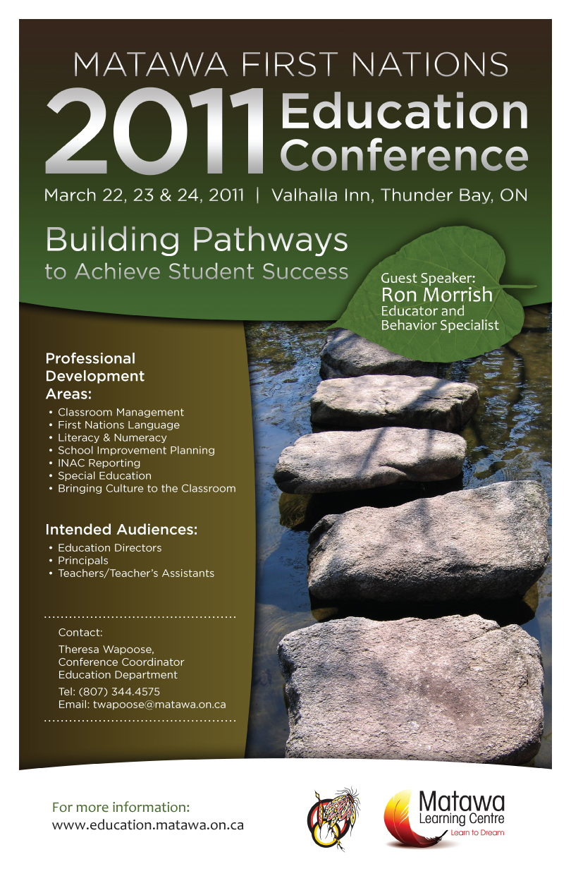

Slide 19
Major Activities 2010-2011
Student Assessments
Review of school resources, policies and practices
Use and needs study of Regional Web-Based Teaching Tools
Literacy and Numeracy coordinators develop student assessment policies and procedures

Slide 20
Activities 2010-2011
Student Assessments
Purchase Web-Based Teaching Tool (WBTT) for each school and provide training
Purchase instructional resources to support effective literacy and numeracy instruction and assessment for each school
Pilot community-based program support (Eabametoong)

Slide 21
Activities
Performance Measurements
Consultation to determine indicators of school/student success
Review school IT infrastructure, policies and procedures
Purchase and set-up Dadavan system
Development of template IT policies and procedures
Upgrade school infrastructure to support Dadavan system

Slide 22
Partnerships
Geraldton Public High School
Lakehead District School Board
NAN Education Partnerships Program
Lakehead University in Thunder Bay
Ontario Institute for Studies in Education (OISE)
Confederation College
Matawa Ring of Fire Special Projects Initiatives (SPI)

Slide 23
Impact /Improvements
Education Planning
Communications
Teacher recruitment and retention
School and student resources
Funding
Technology/databases
Partnership development
Political advocacy
Working together/regional collaboration

Slide 24
Why We Are Unique…
First Nation-focused brand and visual identity strategy for FNSSP
Continual Community Consultation
Stakeholder Involvement – students, parents, Educators, Chief & Council
Membership driven programs
We always put student needs first

Slide 25
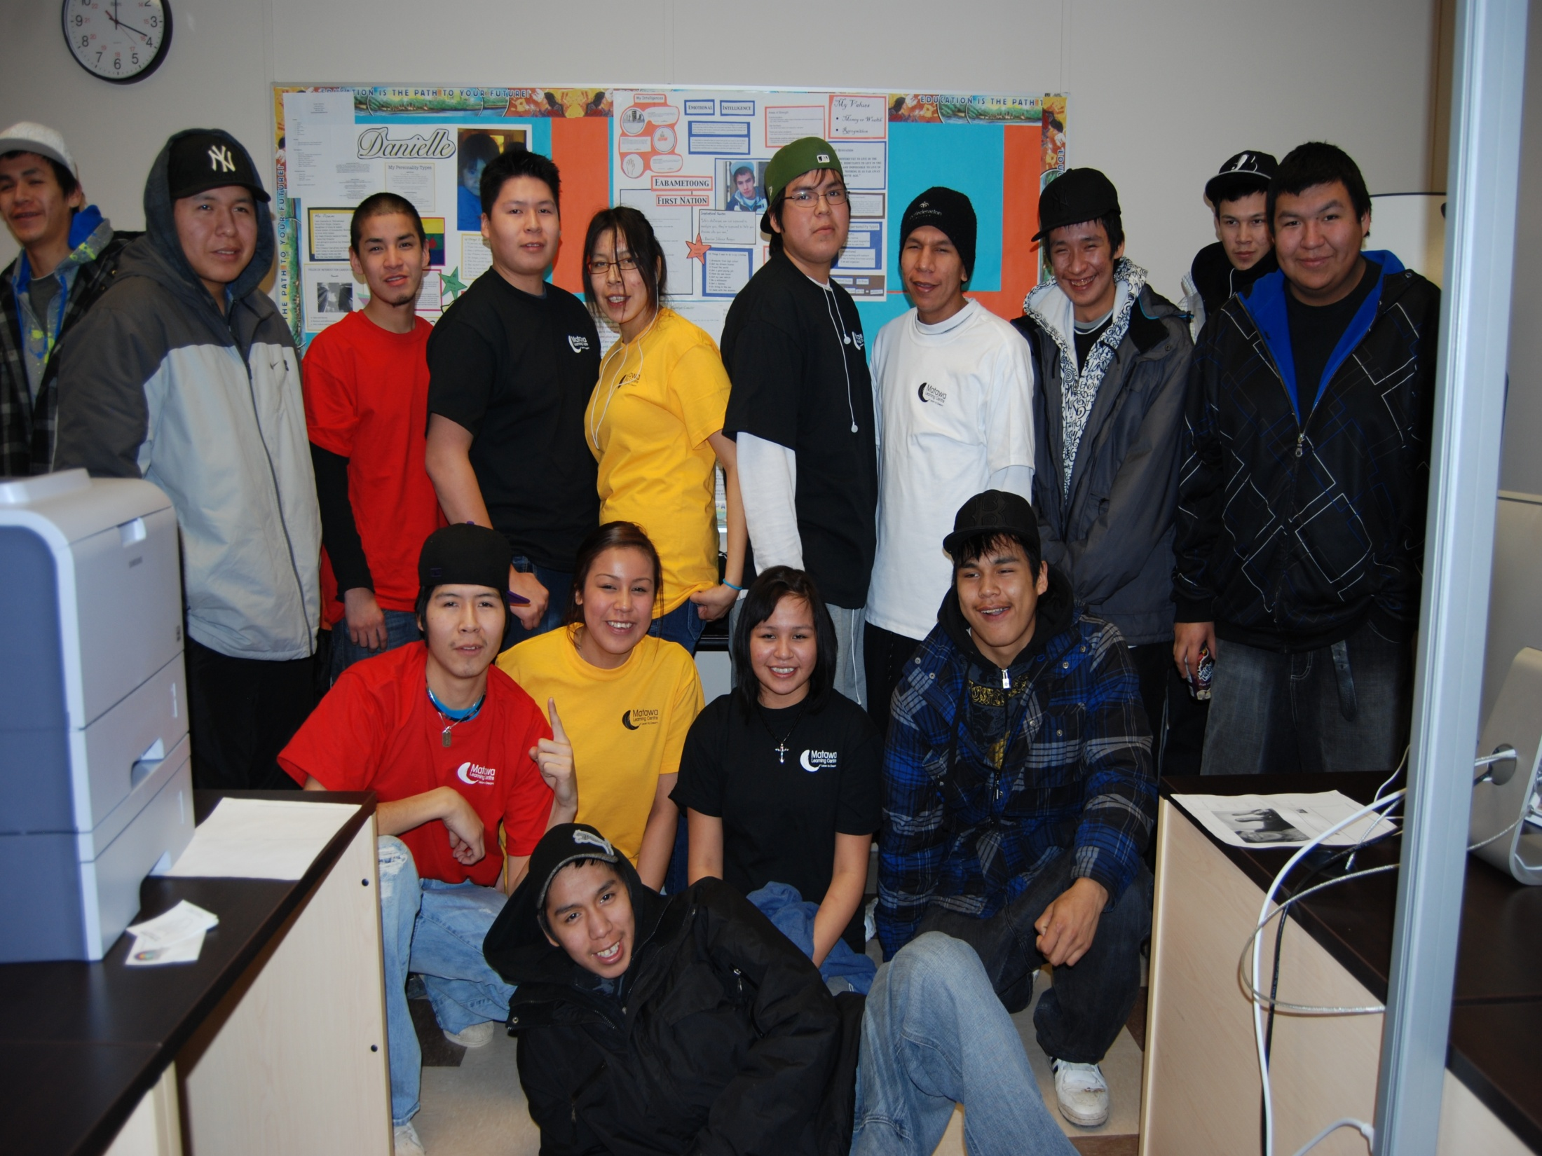

Slide 26
Results = Student Success!

