Slide 1

Ambe Maaji Makzhiwedaa
“Paddles up”
Curve Lake First Nation
Student Success Program

Slide 2
Organization and Governance
Curve Lake First Nation is a community of 800 on-reserve members situated in Southern Ontario amidst the Kawartha Lakes, and within 40 minutes of a University, College and Regional Health Centre in Peterborough.
Total membership now exceeds 1,800.

Slide 3
COMMUNITY
SUPPORT STAFF
TEACHERS
COMMITTEE
CHIEF AND COUNCIL
GENERAL MANAGER
MANAGER OF EDUCATION
PRINCIPAL
FNSSP COORDINATOR
Contracted Literacy and Numeracy Specialists
Reading Tutors, Project Support Education Officer

Slide 4
Our junior kindergarten to grade 3 school is home for 48 students and our team is comprised of…
Manager of Education
FNSSP Coordinator
Dual role Principal and Resource Teacher
5 Teachers (including Language Instructor)
Project Support Education Officer
Language and Cultural Assistant
Education Assistant
Secretary

Slide 5
Supporting Success

Slide 6
Structures for Success
Year long assessment plan
Regular PLC meetings
Teacher developed goals focused on student learning
Formative and Summative assessments for learning

Slide 7
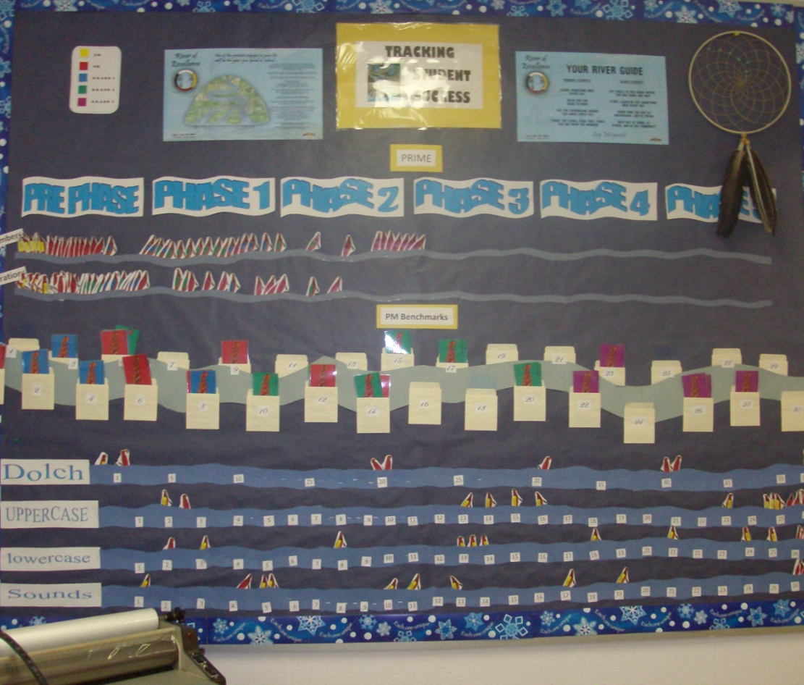
Our Learning Community…
Where are we?
Where are we going?
How are we going to get there?
What will we do if they succeed….
What if they don’t?

Slide 8
Monitoring Success
Literacy
Numeracy
Literacy and Numeracy standardized test results (EQAO, CAT 1V)
Dolch Word lists
PM Benchmarks
Readiness, Red Flags and Nipissing screenings
Formative Assessment
Literacy and Numeracy standardized test results (EQAO, CAT 1V)
Prime Math Assessment
Readiness, Red Flags and Nipissing screenings
Formative Assessment

Slide 9
Monitoring Success
Attendance & Student Retention
Technology
Monthly Attendance Rates
Graduation Rate
Number of Teaching days
Retention Rate
Transitions
Monitoring use of Smartboard, Elmo, Data system, laptops, online resources

Slide 10
Monitoring Success
Community/Parent Involvement
Positive Learning Environment
Attendance at Evening events
# of school volunteers.
Professional Development
# of School Cultural activities
Anishnaabemowin Classroom Checklists and Ojibway Reports
Progressive Discipline
# of incident reports

Slide 11
Program Highlights

Slide 12
Project Timeline:
 | School Success Plans | Student Learning Assessments | Performance Measurements
Year 1 | Develop Student Success Team and PLC Identify Goals for Student Success Create School Success Plan Communicate Plan to Stakeholders Begin to collect data Identify and solve material deficits | Identify assessments for literacy and numeracy achievement Develop year long plan for assessment Professional development on formative assessment. Compile benchmark data Reporting to stakeholders | Identify performance indicators Monitor data collection Define requirements for data system Evaluate options and select system Contract local company to set up server
 | Monitor and Maintain progress in PLC Reporting to Stakeholders | EQAO CAT 1V | Implement OUTCOMES Upload Student Information

Slide 13
Project Timeline:
 | School Success Plans | Student Learning Assessments | Performance Measurements
Year 2 | Update improvement plan based on data Continued PLC Monitor and Maintain progress Continuous data compilation and evaluation Reporting to Stakeholders Planning for sustainability Identify and solve material deficits | Professional development Yearly assessment plan Compile and compare benchmark data Evaluate EQAO and CAT 1V results Reporting to Stakeholders EQAO CAT 1V | Training for Attendance Training for Reporting Identify areas for improvement

Slide 14
Project Timeline:
 | School Success Plans | Student Learning Assessments | Performance Measurements
Year 3 | Update improvement plan based on data Monitor and Maintain progress in PLC Continuous data compilation and evaluation Reporting to Stakeholders Planning for sustainability | Professional development Yearly assessment plan Compile and compare benchmark data Evaluate EQAO and CAT 1V results Reporting to Stakeholders EQAO CAT 1V | Training for various modules including behavior, EQAO, CAT 1V etc. Full implementation of OUTCOMES

Slide 15
Best Practices…
PRIME Math program
Community volunteers Reading Tutors Program
ESSO family math program
Violin lessons for all students
Parent Circle
Author visit
Handwriting without Tears program
Incorporation of technology in teaching and learning
Variety of Clubs and activities e.g.Drama, Culture, Jump rope for heart.
Student Created Language Picture Dictionary
Niibiish and Miigwiy for Language and Seven Grandfathers
Immersion activities including Elder visits, Dog-Sled demonstration, Rabbit and Bear Paw puppet visit
Parent Volunteers
Professional Learning Community
Programming and transitional collaboration with the community
Literacy volunteer teacher for all students

Slide 16
Making a difference!
Improved achievement in PM Benchmarks and PRIME
More than ever we have community involvement in our school. (Increased # of parent volunteers)
School-wide Anishnaabemowin use has increased. (Increased incidents of usage in the classrooms)
Collaboration between our school, health and day care services. ( increased # of meetings)

Slide 17
Sustainability of success…
Our School Success Plan is structured for multi-year usage. Assessments for literacy and numeracy are scheduled for reporting in November, February and June and coincide with report card timelines.
Professional Learning Community.
Updating school policies and procedures to include School bullying interventions and preventions , progressive discipline and promoting positive student behavior and code of conduct .
Creating and maintaining positive relationships within the community; volunteer incentives and recognition, early learning community and transitional initiatives.

Slide 18
How are we unique?
River of Excellence, department wide concept for all students
Community Reading Tutoring Program in collaboration with Trent University’s Faculty of Education
Student Illustrated Anishnaabemowin Picture Dictionary
7 Grandfathers Social Skill Program
ESSO Family math
Programming for the Arts and Immersion
  Violin lessons, cultural immersion days, Elder visits, Lunch n’ Learn

Slide 19
Provincial Partnerships

Slide 20
Transitions and Support Services
Connections with the local school board include;
  Some access to second level services including Speech and Language, Occupational Therapist and Behavior.
  Transitional collaboration with Administration and Staff at the provincial schools.
  Membership with the local school Boards’ Advisory Committees on Aboriginal issues.
Community partnerships include;
  Collaboration with Day Care, Library, Health and U.O.I. programs
  Community Services; Five Counties Children’s Centre and Community Care Access Centre

Slide 21
Miigwetch!!

