Slide 1

Bimose Tribal Council
First Nation student success program

Slide 2
Our Staff
Jim Green-Education Advisor for Bimose
Andy Graham-Education Coordinator
Eva Graham-Literacy Specialist
Donna Babiachuk-Student Success/Student Retention Specialist
Ray Petiquan-Information Service and System Technician
Bob Thompson-Data Management Technician
Fay Zoccole-Student Behavior Support Specialist-New Path

Slide 3
Timelines
May-July 2010-The FNSSP Workplan was Developed and Approved by INAC
August 2010-Program Coordinator was hired by the Advisory Committee
September 2010-Literacy and Student Success/Student Retention Specialists were hired
December 2010-Data Management and Information System and Service Technicians were hired

Slide 4
Timeline
January 2011-Student Behaviour Support Specialist was hired through New Paths program

Slide 5
Organization and Governance
We currently have 5 communities involved in our program, with a 6th community joining as of April 1st, 2011
School | Community | Number of Students | Number of Teachers
David Kejick (K-8) | Shoal Lake 39 | 85 | 9
Wabaseemoong (K-12) | Wabaseemoong (Whitedog) | 310 | 23
Ojibway Heritage (K-8) | Shoal Lake 40 | 42 | 6
Wapshki Penasi School (K-6) | Wabagoon Lake | 26 | 4
Migisi Sahgaigan School (K-6) | Eagle Lake | 25 | 5
Sakatcheway School (K-12) | Grassy Narrows | 218 | 17

Slide 6
Organization and Goverance
Our schools are all within a 1.5 hour drive from our central office in Kenora
Most of our professional development sessions are in Kenora
Currently Bimose Tribal Council has 9 member communities with 5 schools

Slide 7
Organization and Governance
Advisory Committee
Our Advisory Committee consists of one member for each community and one member from the Bimose Tribal Council Board of Directors
The Committee meets once a month.
There role includes:
  Budget development and approval
  Hiring of all staff
  Approval of new programs/program changes
  Review all new proposals

Slide 8
Organization and Governance
Advisory Committee
The committee has completed a Draft Terms of Reference to ensure consistency and define and authority of the group
The committee also has a Chair and Vice Chair, with plans to establish various working committee (i.e. finance and Human Resource)
The Draft Terms of Reference also outlined the ways the committee could move into more aggregate of services (i.e. New Paths proposals)

Slide 9
Organization and Governance
Development of an RMO
Our advisory committee and tribal council is looking into the possibility of creating a RMO or Education aggregate
The advisory committee agrees that shared 2nd level services would be of great benefit to their schools but do not wish to see direct administration of the schools
Focusing in developing and implementing 2nd level shared services and enhancing partnerships is key

Slide 10
Policy
Monitoring Program Areas:
Regular reporting to the Advisory Committee and our Education Authorities
Developing implementation scheduling in consultation with the schools
Developing common reporting dates and timelines
Almost all of the implementation of the program components are centrally administered
Creation of District Reviews in our schools

Slide 11
Policy
Performance Indicators
PM Benchmarks (K-4) and Fountas and Pinnell Benchmarks (4-12) (Completed)
EQAO Grade 3 and 6/OSSLT (All Schools)
Student Surveys (Completed in Nov 2010)
At-Risk Student Interviews
Provincial Student Success Indicators (i.e. Graduation Rates)

Slide 12
Policy
Future Performance Indicators
Report Card Data
CAT 4 Tests (Yearly Implementation)
Project/Planning Data
Teacher Surveys
Student Success Transition Data
Numeracy Data
Ontario Writing Assessment
Oral Language Assessment
Classroom Environmental Scans

Slide 13
Policy
Supporting Performance Measure
Implementation of the Trillium Data System
Creating a secure IT infrastructure/server
Creation of common reporting templates (i.e. Student Success Indicator Sheet, Benchmarking Sheets, Common Kindergarten Report)
We are moving to support a paperless data environment

Slide 14
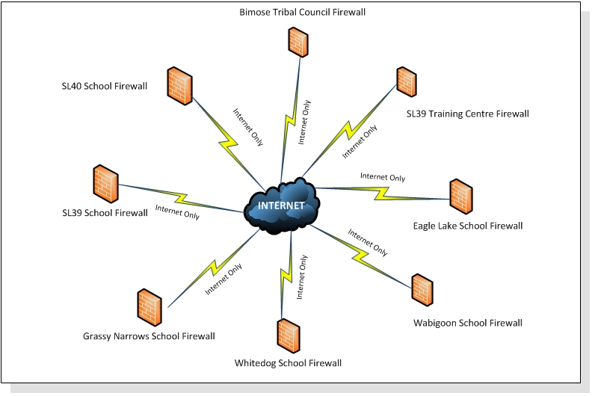
Policy

Slide 15
Policy
December 2010: External Network Configuration Overview
As of December 2010 all the schools involved with FNSSP were standalone networks accessing the Internet through their respective ISP’s·
All firewalls were basic wide open “firewalls”, very limited security features·
No secure connections to any other site

Slide 16
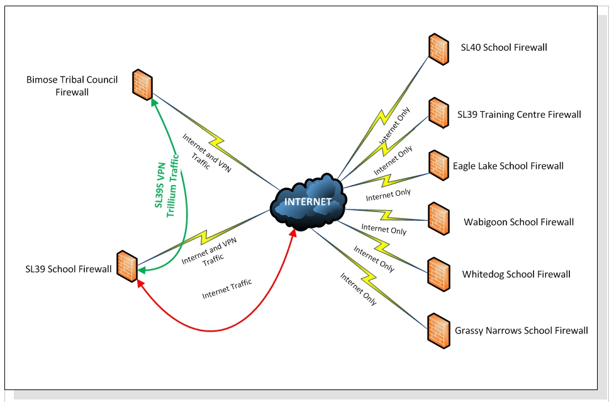
Policy

Slide 17
Policy
March 2011: External Network Configuration Overview
Bimose Tribal Council and Shoal Lake 39 School firewalls have been upgraded to higher-end feature rich units
Bimose Tribal Council’s internal network switch equipment is being upgraded to higher-end units, the upgrade is 80% complete
Configuration of a site-to-site VPN has been configured from Shoal Lake 39 School to Bimose Tribal Council
The VPN connection is part of the Trillium report card system implementation. All Trillium network traffic will go over this connection to the Trillium database at BTC

Slide 18
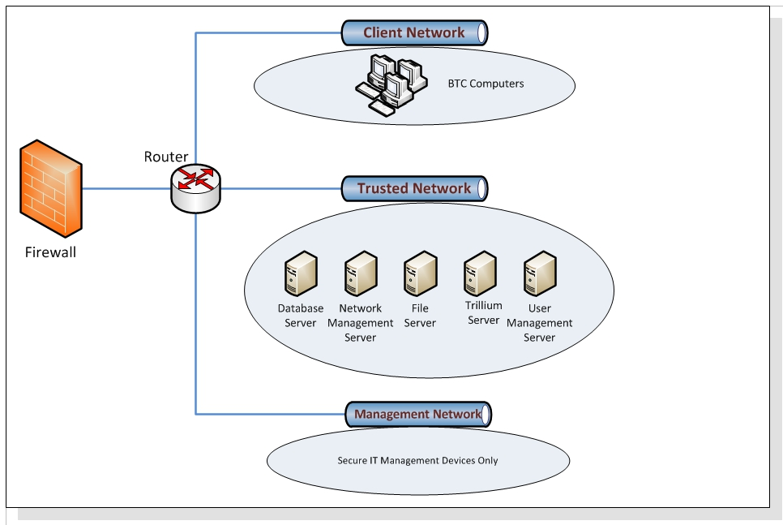
Policy

Slide 19
Policy
March 2011: Bimose Tribal Council Internal Network Overview
Bimose Tribal Council has totally redesigned its internal network into segmented traffic groups based on device rolls
Notable Infrastructure Improvements
  Complete network and server redesign
  Nighty backup to secure network storage
  Complete environmental and network monitoring
  Monitoring alerts sent to IT cell phones
  9 hour UPS backup power for network and servers

Slide 20
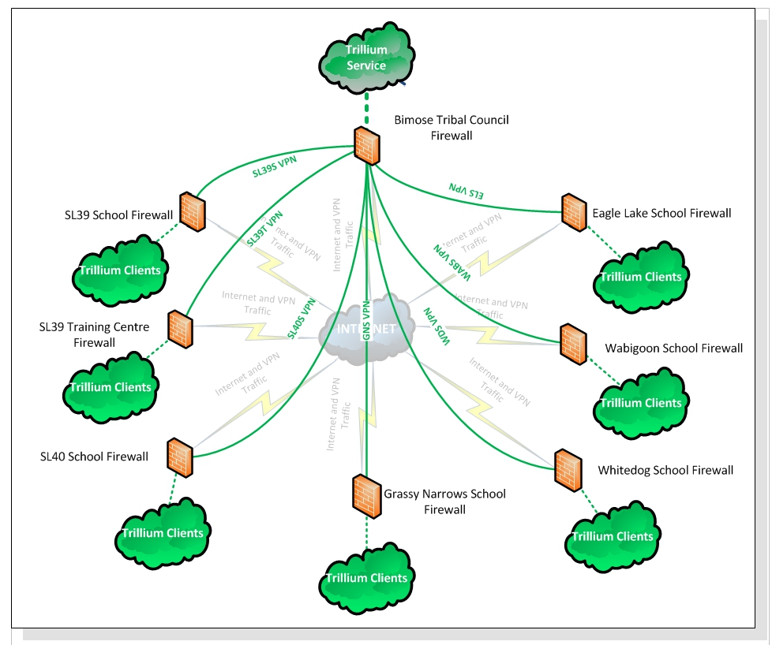
Policy

Slide 21
Policy
Student Management Planning: Trillium Network Setup
This is the planned Trillium setup for the schools. Each school has a secure VPN connection back to Bimose Tribal Council·
Only approved Trillium clients will be allowed access to the database·
All logical security to the database will be setup as required
All non Trillium traffic will be sent over the Internet

Slide 22
Policy
Supporting Performance Measures
Professional Development for all Staff
  Debbie Diller-December and May
  Nelson Canada
  EQAO/CAT4 Testing
  Sue Johnson-January and June
  David Booth
  Handwriting Without Tears
  Lion’s Quest
  Lab Classrooms

Slide 23
Policy
Supporting Performance Measures
Central Program Support
  Regular scheduling of visits by program staff
  Focused common program implementation (i.e. Literacy Rooms and Coop Programs)
  Purchasing of common resources in each school.

Slide 24
Policy
Performance Measurement
More networking and the establishment of functioning PLCs and TCLPs
Enhanced data collection and interpretation tools
Refinement of our District Review process and closely tying it to our school effectiveness plans

Slide 25
Program
Current Timeline:
To date, we have met all of our timelines and program goals (all timelines have been met on time or ahead of schedule) with the exception of the final implementation of our data collection system.
Our Trillium system will be up and running by mid-May

Slide 26
Program
Literacy
Completed a literacy resource inventory in all schools to determine specific needs.
Establishment of literacy libraries in each school
Purchased the Nelson Literacy Program from JK-Grade 10 for each school.
Completed a 2 day professional development session on Balanced Literacy and Guided Reading.
Completed a 2 Day professional development session to support the Nelson Literacy Program and the EQAO Testing.
Completed a 1 day professional development session on Literacy Best Practices

Slide 27
Program
Literacy
Purchased all materials and equipment to set-up Literacy Centres in all JK-Grade 3 classrooms.
Worked with teachers to establish Guided Reading and Literacy Centres in their classrooms.
Implemented the PM and Fountas and Pinnell Benchmarks in all schools.
Purchased First Nation books and Literacy resources for all of our schools
Beatrice Culleton, author of ‘April Raintree’ will be visiting our schools in May
Writing Anthology for our schools
Authors’ Workshop for the Fall

Slide 28
Program
Literacy
Welcome to Kindergarten
Online Language Dictionary
School Twinning in Southern Ontario
Parent support sessions in each community
  Benchmarks
  Home reading program
  Tips to support students

Slide 29
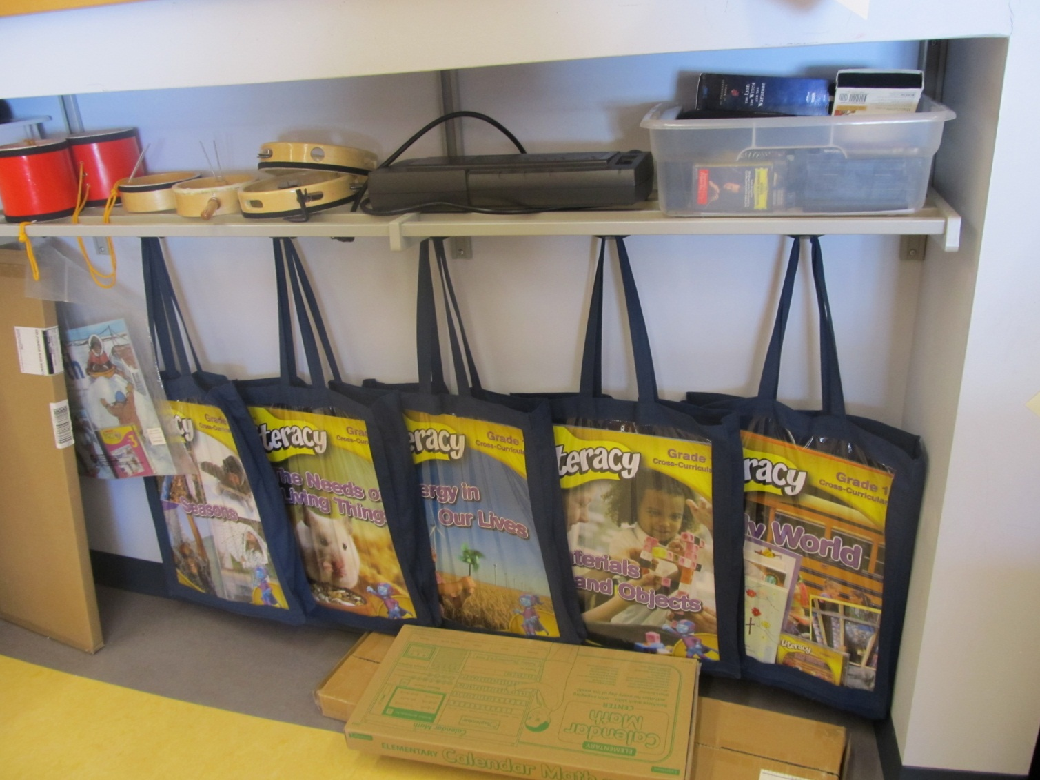
Program

Slide 30
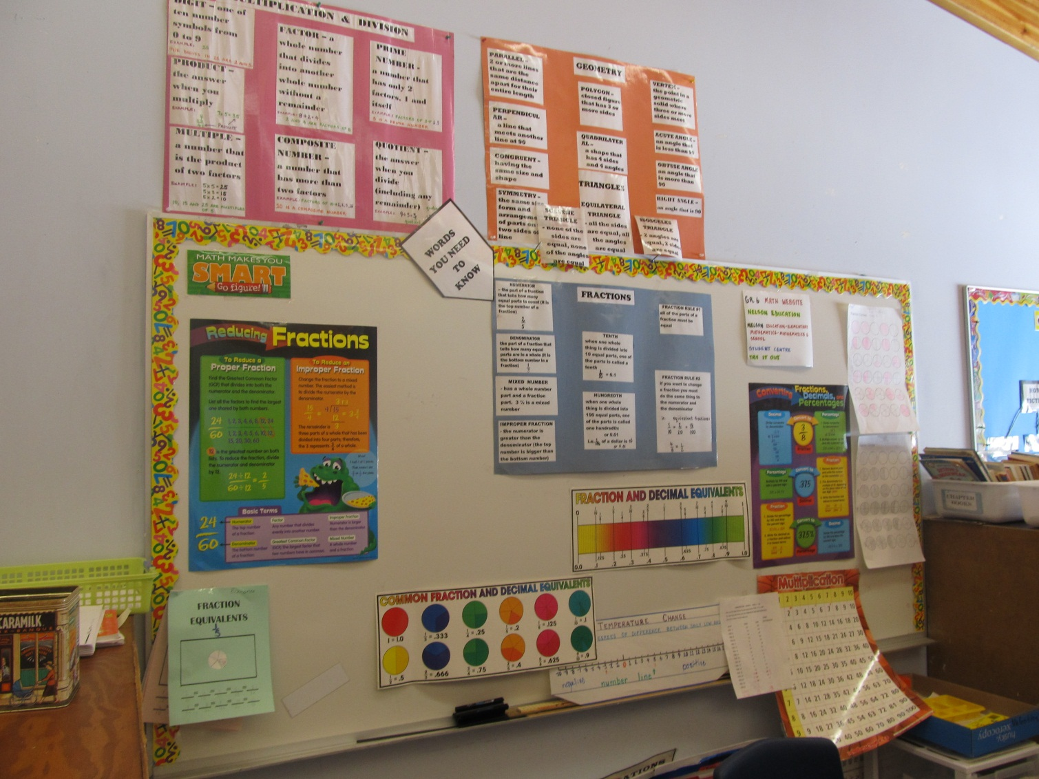
Program

Slide 31
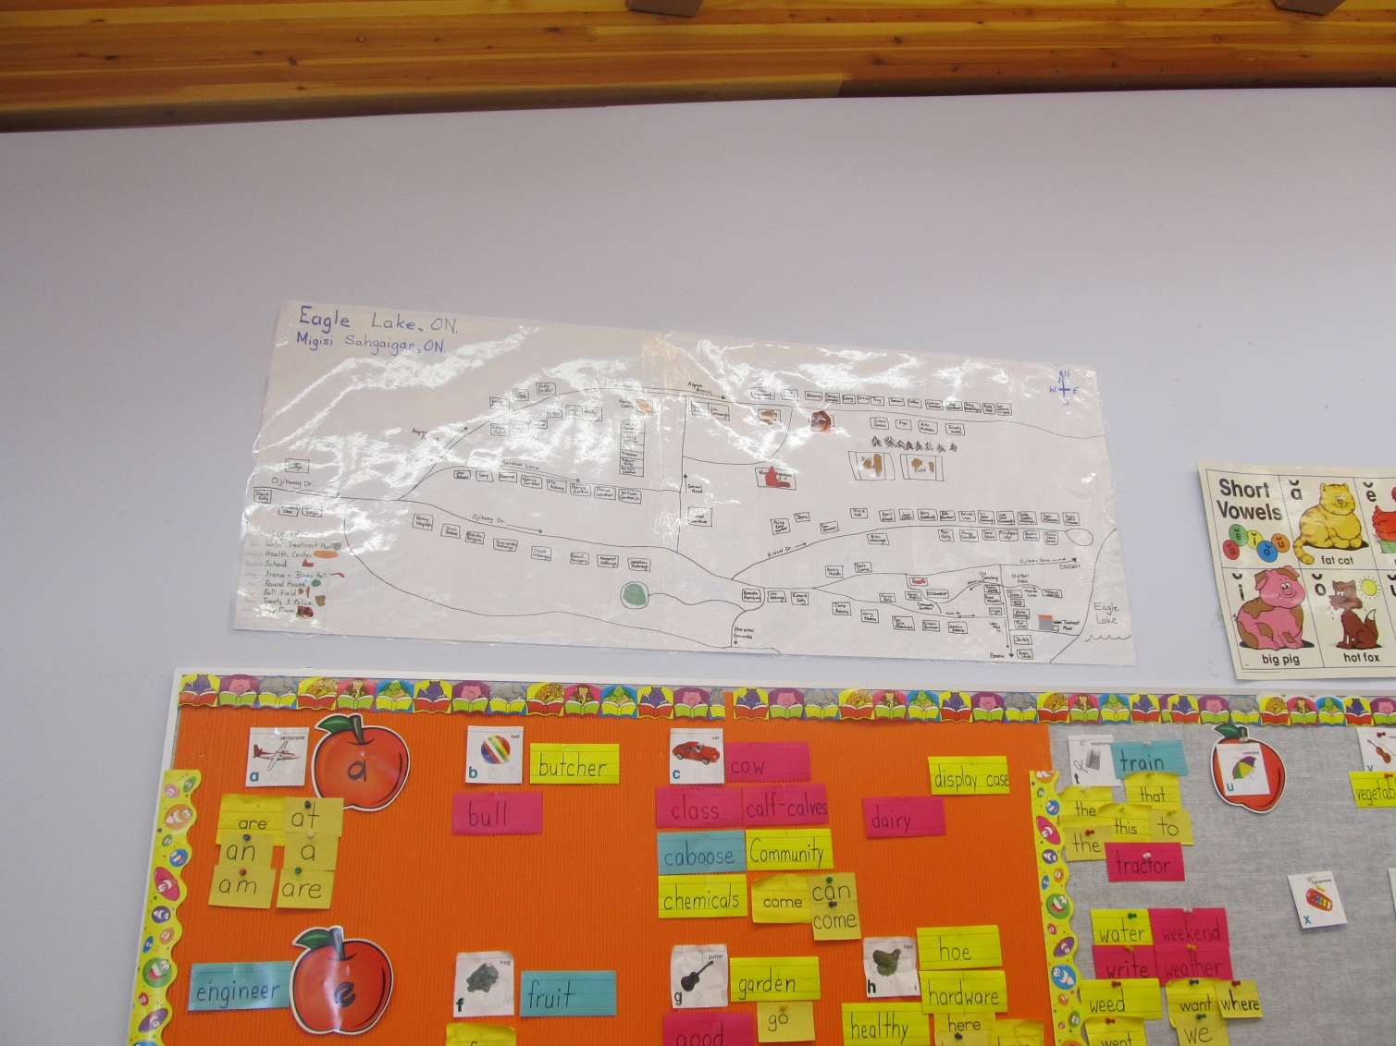
Program

Slide 32
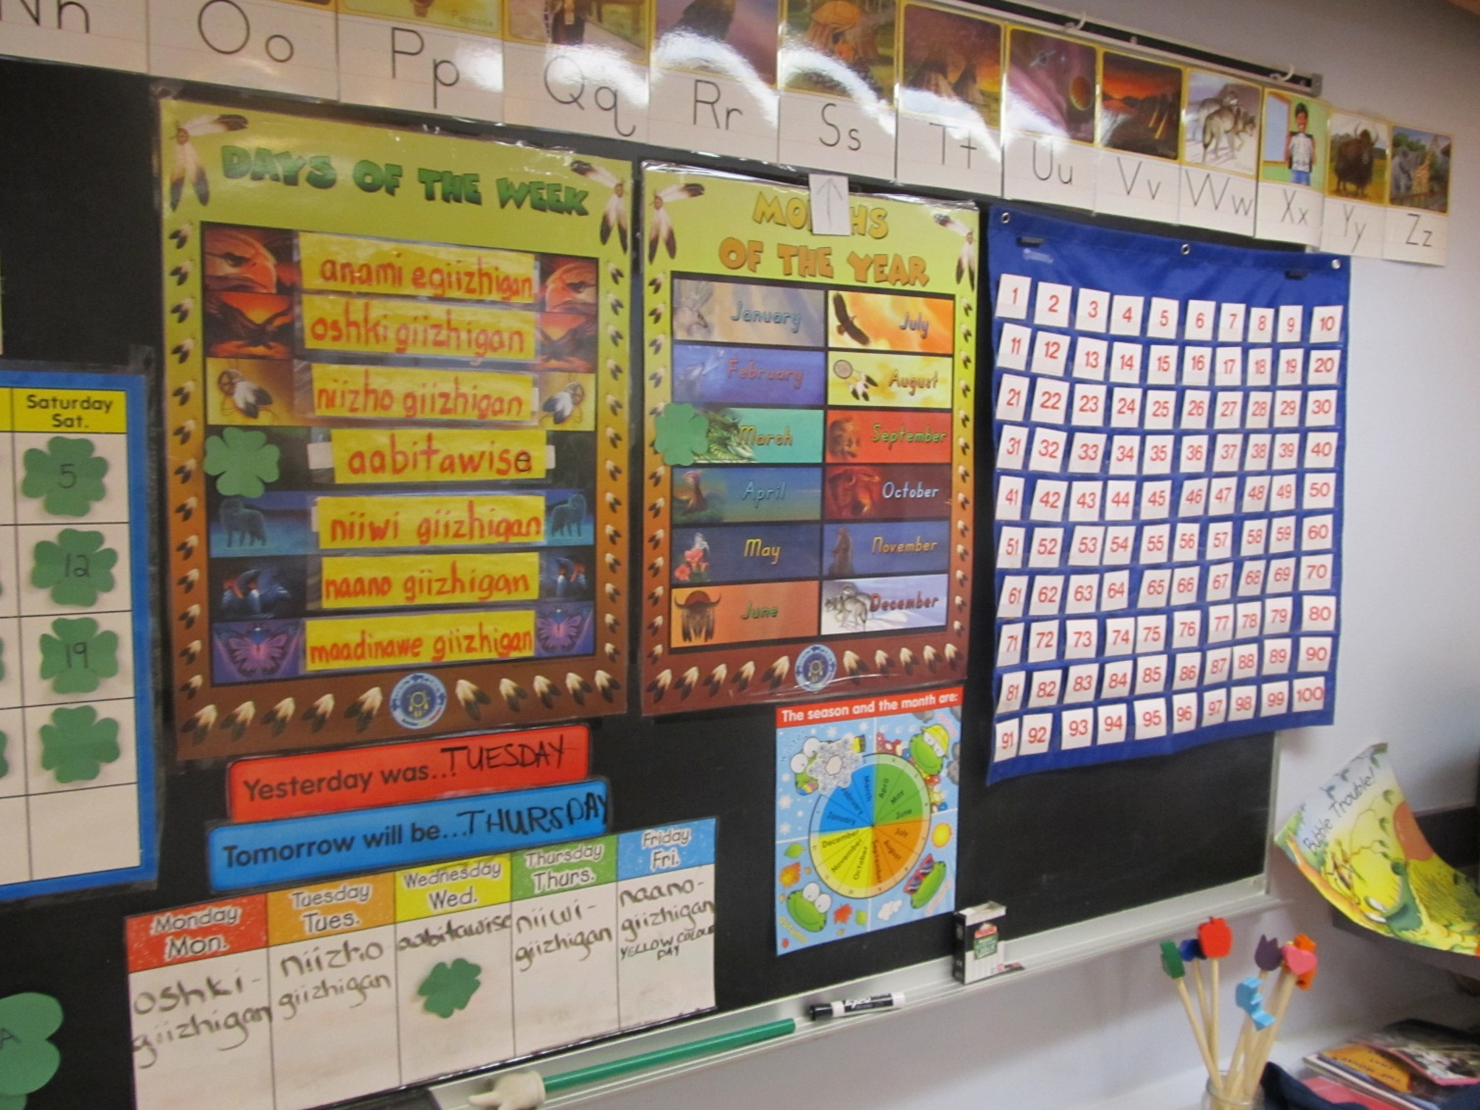
Program

Slide 33
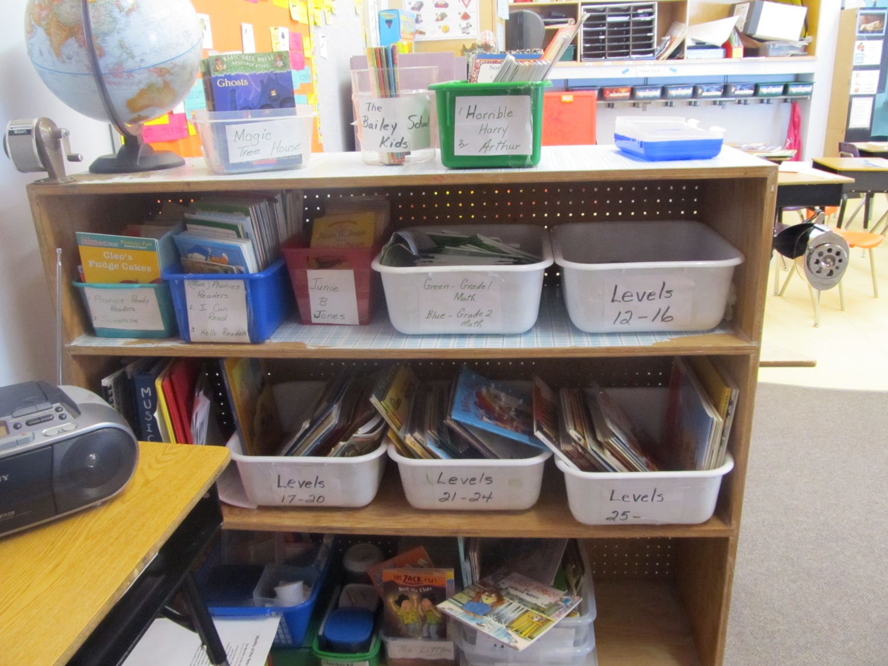
Program

Slide 34
Program
Student Success/Student Retention
Established a Co-op Program at the two High Schools.
Completed a student survey of all Grades 4-12 Students.
Organized a professional development session for the Education Counsellors.
Organized a parent survey for each school.
Organized a detailed interview process for students at the two High Schools who have dropped out of school.
Organized a High School Teacher’s meetings to discuss secondary issues.

Slide 35
Program
Student Success/Student Retention
Began the establishment of a Fiddling Program at each school.
Organize Student Success Teams in our two High Schools
Organized 2 professional development sessions for our Ojibway Teachers in conjunction with Keewatin-Patricia District School Board.
Began the process of entry the two High Schools into NorWASSA Sports Competition
Supported a student language session at Shoal Lake 39 to discuss language retention

Slide 36
Program
Data Management and Information Technology
Began the set-up of the Trillium Student Data Software on the server and at each school.
Purchased and set-up 12 SMART Boards.
Purchased and set-up new administration computers for each school.
Purchased and set-up a new server to store student data.
Investigated the set-up of LIVE@EDU in all of our schools.

Slide 37
Program
Data Management and Information Technology
Completed an inventory and analysis of all of the computer systems in each school.
Established a remote link to each school server.
Addressed any maintenance issues as they have arisen.

Slide 38
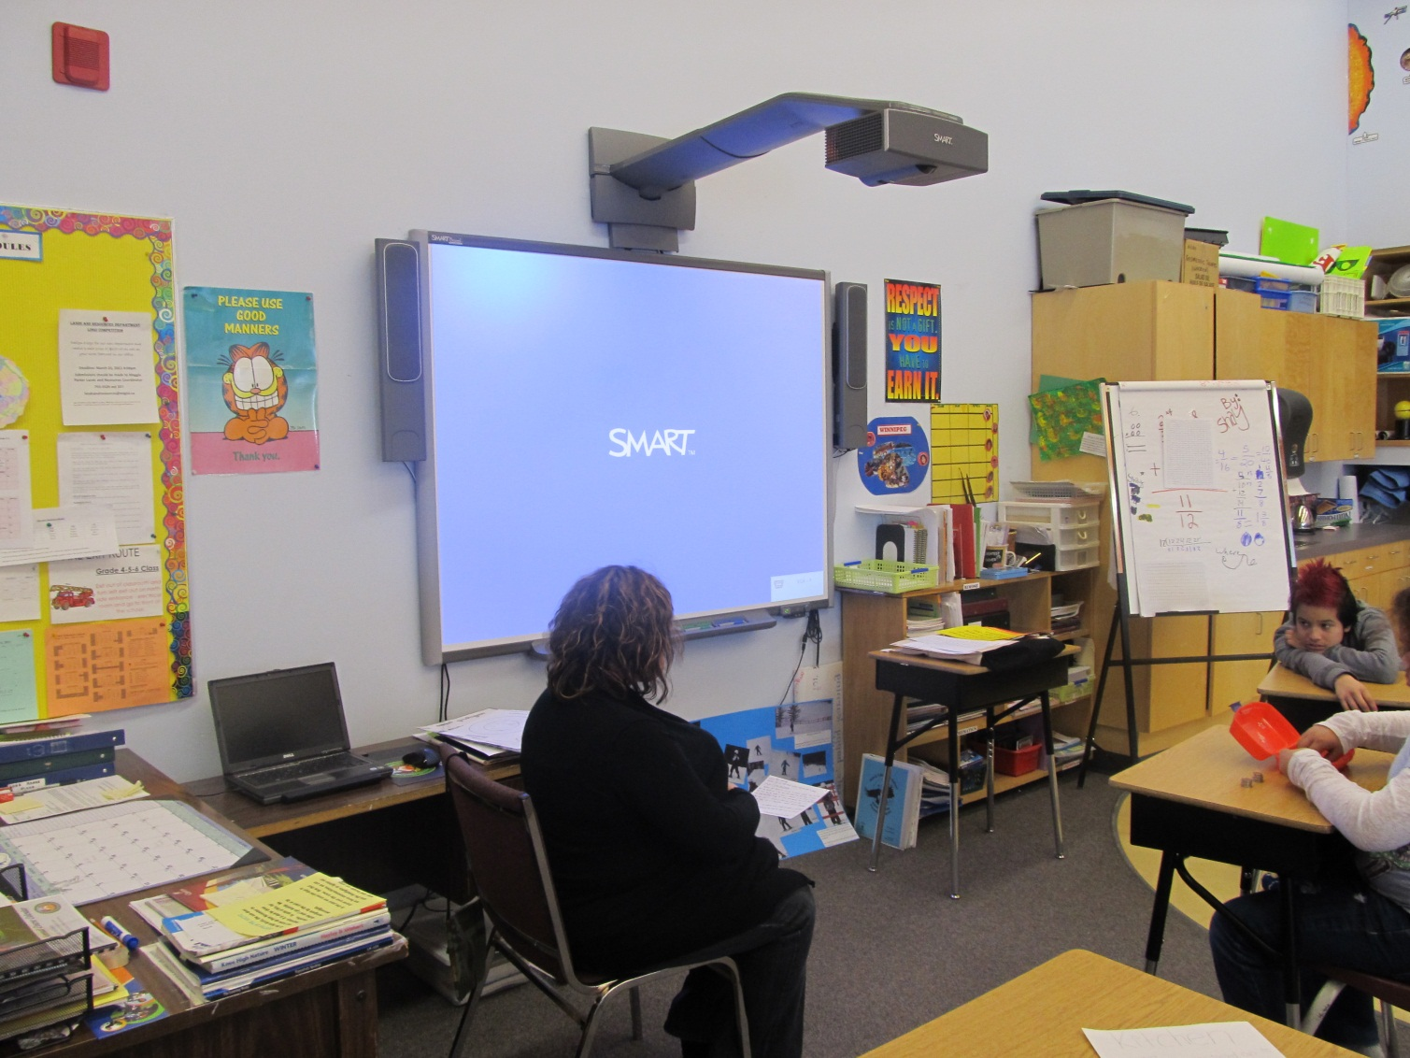
Program

Slide 39
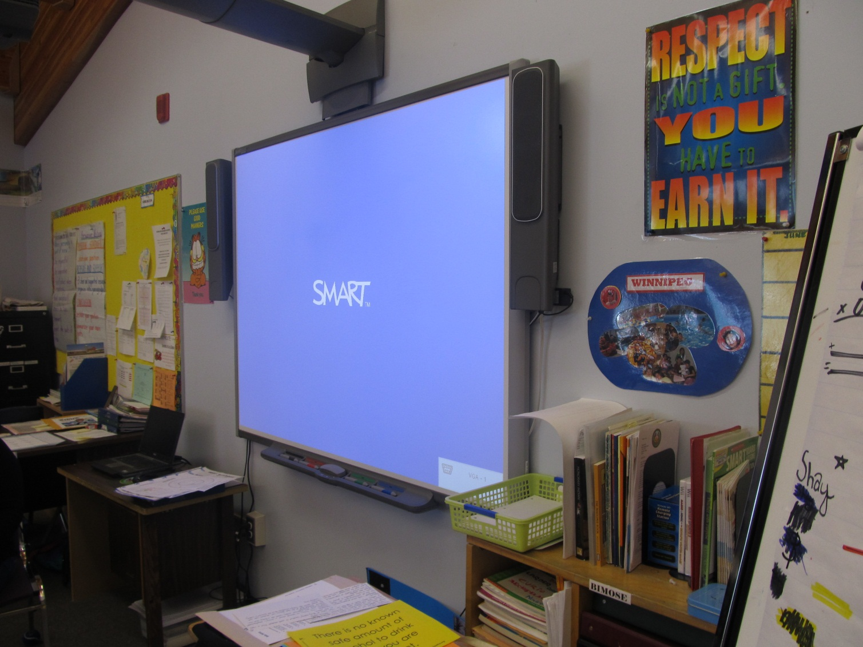
Program

Slide 40
Program
Student Behaviour Support
Organized Professional Development for ‘Handwriting Without Tears’, Lion’s Quest and Anti-Bullying with Barbara Colloroso.
Completed a training session with staffs on fine/gross motor skills.
Met with all special education teachers and most classroom teachers to review any students with behaviour issues and suggestions for professional development.
Continuing Learning Lunches/ Teacher Workshops on a variety of topics.
Developed a common Special Education handbook for our schools with IEP templates

Slide 41
Program
School Effectiveness Plans
Our initial school plans involved a needs assessment and identification of common practices/materials for each school.
Our next step will be the be the implementation of the provincial School Effectiveness Framework planning process in our schools

Slide 42
Program
School Effectiveness Framework
The framework is a continual planning process that focuses on 4 key areas-Literacy, Numeracy, Pathways and Culture, Community and Caring
The schools will be involved in annual District Reviews that look at the success of their plan
Some funding will be flowed to the school to support their plans
PLCs and TCLPs will also support their plans

Slide 43
Partnerships
Partnerships with Local School Boards
Currently we do not share services agreements with our 2 local school boards
We have been invited to participate in KPDSB’s Native Language PD sessions
The two local boards have sent representatives to our PD sessions
Our secondary students have participated in a Secondary Health and Wellness Forum.

Slide 44
Partnerships
Future Partnerships
Development of a Evening Fiddling Program in the Kenora area
The development of a high skills major type of program that would be run at our two high schools and at the two public secondary schools based on Environmental Studies
More formalized PD planning (i.e. use of common PD days)

Slide 45
Partnerships
Provincial Level
We currently receive no provincial funding
Regionally, we have been invited to participate in all NOEL (Northern Ontario Education Leaders) projects and initiatives, but we have not been allowed to participate in the Directors meetings yet.
We are in the process of becoming a member of the regional data warehouse through Compass to Success (Cognos)

Slide 46
Partnerships
Provincial Level Cont.
The LNS as allowed our teachers to participate in all initiatives and projects (i.e. Schools in the Middle)
The regional office of the MOE has also invited all of our program staff to any regional meetings.

Slide 47
Partnerships
Future Provincial Partnerships
NorWASSA membership for our schools
We applying to a number of provincial programs for funding to support our schools and program
  NOHF-Emerging Technology Fund
  NOHF-Youth Internship program

Slide 48
Partnerships
Other Partnerships
Common Ground Initiative
University of Manitoba/Confederation College/AKRC Post Secondary Program
Apple Canada/Smart Canada
Welcome to Kindergarten program though The Learning Partnership

Slide 49
What Makes the Bimose Tribal Council FNSSP Great
Strong community and staff support
A focus on technology to promote learning (i.e. IPADS in all of our classrooms)
A strong focus on best practices instead of using a set program
Strong partnerships
Strong planning process
Getting the best of the best for our schools, staff and students
Common spirit of success
A willingness to think ‘outside the box’

Slide 50
Miigwetch
From the Staffs and Students of the
Bimose Tribal Council FNSSP

